Slide 1
IT Solutions for the Islamic Microfinance Industry
Global Islamic
Microfinance Forum
1 - 4 November 2014
Dusit Thani Hotel - Dubai
Syed Ahmed Zafar
Territory Account Manager
Sales
Path Solutions

Slide 2
Possible Challenges in Islamic Microfinance
Financial products that comply with Shariah law
Diversity of products to cater for the Islamic Microfinance requirements
Sustainable business models that incorporate operational efficiency and risk management
IT solution that can support and drive the Islamic Microfinance activity
Capacity building at both the macro and micro levels
Sources of funding

Slide 3
Ultimate Goal for the Islamic Microfinance Industry
Create successful and prudent Microfinance sector that can bring impact to the socio economic development among the poor
Moving from poverty alleviation to entrepreneurial development as a natural progression and outcome of the Microfinance program
Create growth and self-sustainable Microfinance organizations, and reduce reliance on external sources of funding
Microfinance as an effective platform for financial inclusion among the unbanked, voluntarily or involuntarily financial excluded segment

Slide 4
Usage of IT in Islamic Finance and Microfinance
Systematic data management, consolidation and reporting
Bird’s eye view of the organization achievement and growth
Improve productivity and efficiency at both operational and business level
Shariah compliant processes and behavior
Support diversity of products and innovation
Support growth and sustainability of the organization
Proper risk management and reporting

Slide 5
About Path Solutions
Path is a Kuwaiti Shareholding Company
Founded as an IT Consultancy Firm November 1992
Beirut development center October 2000
Bahrain support office October 2003
London support office February 2007
Kuala Lumpur support office September 2007
Karachi support office April 2009
Riyadh support office August 2009
Jakarta support office November 2009
Khartoum support office December 2009
Egypt development center November 2010
Dubai sales office July 2011
India development center July 2013

Slide 6
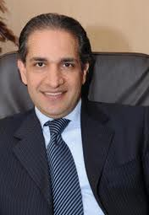
Our Vision
To be the most trusted and innovative provider of information technology solutions and services for the global financial industry & in specific the Islamic financial industry.
High quality in our products and services is vital to the success of our clients and partners. In helping our clients and partners become successful, we must strive to maintain the highest ethical standards and integrity. To achieve these goals, it is our policy to involve all employees in programs to improve our products, services, and the efficiency of our internal processes.
Mohammed Kateeb
Group Chairman & CEO
Quality Code

Slide 7
Our Vision
All of Path's solutions are developed in-house, implemented by Path and supported directly by Path

Slide 8
Our People
6 Employees in 1993
20+ Employees in 1997
64+ Employee in 2005
120+ Employees in 2006
205+ Employees in 2007
398 Employees in 2008
450 Employees in 2010
375 Employees in 2011
400 Employees in 2012
485 Employees in 2013

Slide 9
Area of Focus
Path’s offering consists of integrated business solutions and services for the following major business segments:
Islamic Banks
Islamic Investment Companies
Islamic Consumer Finance Companies
Islamic Microfinance Institutions
Universal Banks
Investment Companies and Fund Managers
Financing Companies

Slide 10
Our Products and Services
Our Services include
Project Management
Business & Technology Consulting
Systems Integration
Business Continuity Planning
Customization (Plan matching with the solution)
On-going Maintenance and First Line of Support
Our Products include
Islamic Core Banking Solution - iMAL
Islamic Window Solution - iWINDOW
Financial and Investment Solution for Microfinance - iSHRAQ

Slide 11
Certifications & Compliance
ISO 27001:2005 security certification(ISMS)
AAOIFI Certified November 2008
AAOIFI member since February 2001
CMMI Level 3 and ISO 9001:2008 certified IFSB
Compliance IAS Compliance Basel II Compliance

Slide 12
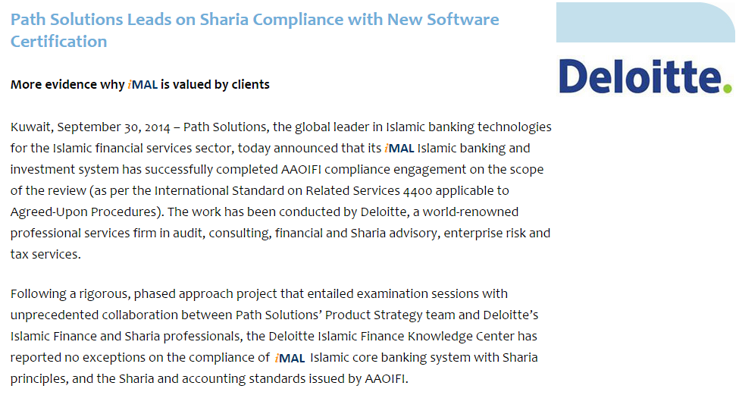
Certifications & Compliance

Slide 13
Path Solutions’ Client Base
2 Clients
7 Clients
13 Clients
24 Clients
59 Clients
74 Clients
81 Clients
92 Clients
in 1992
in 1997
in 2001
in 2005
in 2008
in 2010
in 2011
in 2012
100+ Clients in 2013 - Present
2200
2100
2000
2 7
13
24
2005
59
74
81
92
1900
1992 ₁₉₉₇ ₂₀₀₁
2008
2010
2011
1
2
3
2012
4
5
6
7
Number of Clients
Year
8

Slide 14
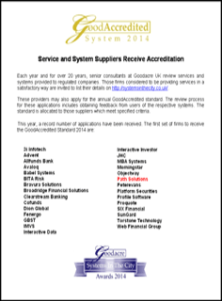
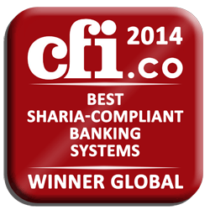
Path Solutions’ Awards 2014
Path Solutions has been named winner for the category of ‘Best Islamic Technology Provider’ at the Global Islamic Finance Awards (GIFA) 2014 in UAE.
Path Solutions recognized Best Islamic Banking Systems Provider in 2014 by World Finance.
Path Solutions won first overall position in the Islamic banking segment in IBS Sales League Table 2014.Path has maintained this position in IBS Sales League Tables since last 7 years.
Path Solutions has won the category of ‘Best Islamic Technology Provider’ for the 6th year running in Redmoney’s IFN Awards Best Service Providers Poll 2013 announced last November.
recognized as ‘Best Global Islamic Banking Software System in 2014’ by the renowned UK-based Global Brands Magazine.
Path Solutions awarded the UK GoodAccredited Standard for 2014

Slide 15
iSHRAQ for the Islamic Microfinance Industry

Slide 16
iSHRAQ Product Suite
Investment
Islamic Financing
Islamic Treasury
Portfolio & Asset management
Fund management
Sukuk management
General Ledger
Private equity
Common Components
Common Components
Swift
Approval Workflow
Data Mart
Business Parties
Scheduled Tasks
Collaterals
Security
Products & Assets
Service Bus
Back Office
Core Banking
Credit Bureaus
Legacy Systems

Slide 17
Functional Architecture
1
Multiple Organizations
2
Multiple Companies
3
Multiple Branches
4
Multiple Currencies

Slide 18
Functional Architecture
5
Multilingual / Localization
6
Real Time Processing
7
Back Date Transaction
8
Task List

Slide 19
iSHRAQ*Finance – Main Components
Facility Management
Corporate and retail finance contracts
Contract maintenance transactions
Legal Entities
Approval Workflow Engine
Collaterals Management
Charge scheme
Collection and Settlement
Provision Management
Limit Management
Scoring Scheme
Transaction, performance, and statistical reports

Slide 20
Legal Entities Management
Vendors
Sales Agents
Market makers
Credit information Providers
Constructors
Clearance companies
Central Banks
Banks
Guarantors
Financers
Customers
Employees
Financial Facilitator

Slide 21
Is Your Customer Credit Worthy?
Individual and Corporate Financial Statements
External Credit Scoring
Weighing Individual and Corporate parameters

Slide 22
Repayment – Setup
Define Installment Intervals
Define Profit Type (Fixed, Floating)
Define Profit Calculation Method
Define Profit Distribution Method

Slide 23
Charges – Setup
Charge Category
Payer
Customer
Charge Occurrence
Per Transaction
Charges Value
Fixed
Financial Institution
Per Installment
Periodic
Financial Institution Fees
General Insurance
Taxes
Multi Tier
Base Rate + Offset %
Percentage
Variable

Slide 24
Collateral – Setup
Select Financial Product
Asset Selection + Coverage%
Asset Rating

Slide 25
Approval Work Flow – Setup
Define Number of Nodes per Approval Work Flow
Define Product
Review Only
Decision
Corporate
Define Assessment Factor
Committee (Assembled/Circulating)
Individual
Assign
Decision Making
Retail
Principle
Profit Rate
Others

Slide 26
Financial Product – Setup
Select Product Component
Define Rules And Eligibility Criteria
Choose From The Created
Repayment Plan
Charges
Collaterals
Others
Define Rule Violation Behavior
Connect the business parties with the following Islamic products:
Murabaha
Musharaka
Leasing
Mudaraba
Istisnaa
Tawarruq
Qard Hassan
Ar-Rahnu
Automatic matching between sub products and applicants (based on applicant's attributes)

Slide 27
Limit Management
Levels
Factors
Transaction
Per Period
Exposure
Financial Product Class or Investment Asset Class
Financial Product or Investment Asset
Customer
Currency
Customer Sector/Category/specific
User Group/Specific User
Region/Nationality

Slide 28
Provision – Setup
Define Sectors
Define Financial Products
Set Provision Rate According to Debt Aging
Set Specific Customer
Set Specific Contract
Set Provision Value
Set Calculation Provision Period

Slide 29
Contract Maintenance Transactions
Change Orders
Full Early Settlement
Partial Early Settlement
Contract Revolving
Reschedule
Contract Switching
Repayment Plans Merging
Profit and Expenses Declaration
Installment Dropping
Item Sale
Contract Termination

Slide 30
Collection and Settlements
Bucket Criteria
- Reminder
- Past Due
- Follow Up
Collector
- Collection Intelligent Notes
- Customer Contract, Contacts Details & Responses History
SMS
Customer Response
Continuous Follow up until Payment
Reports
Follow up
Customer Bucket Level 0
Customer Bucket Level 1
Customer Bucket Level N
Visits
Legal
Calls
Mails
Escalations, Customer Buckets’ Maintenance
Collector performance
Bucket performance
other
….

Slide 31
Collection and Settlements
Standing Instruction (SI)
Bank Transfer
Cash Settlements
Mobile Payment
Payment History/Tracking

Slide 32
iSHRAQ Islamic Microfinance Loan Programs Typical Financing Cycle
Campaign
Booking
Follow-up & Maintenance
Post-Maturity

Slide 33
iSHRAQ Islamic Microfinance Loan Programs Typical Financing Cycle
Campaign
Applicant visit
Application filling
Primary approval
Encouragement meetings
Commitment fee payment
Attendance tracking to induction course
Collection of attendance fee

Slide 34
iSHRAQ Islamic Microfinance Loan Programs Typical Financing Cycle
Collection of required financing application documents
Agreement on financing amount and repayment tenure
Final approval
Takaful coverage
Group forming, leader selection, and setting the periodical meeting date / location
Financing disbursement
Booking

Slide 35
iSHRAQ Islamic Microfinance Loan Programs Typical Financing Cycle
Follow-up
& Maintenance
Periodical meetings for payment collection
Periodical visits to follow up on the usage of fund
Maintenance for the financing facility:
Financing rescheduling
Early settlement
Financing cancellation
Arbitration closures

Slide 36
iSHRAQ Islamic Microfinance Loan Programs Typical Financing Cycle
Post Maturity
Compliance with Microfinance program will allow members to:
Apply for other financing programs before or after current financing maturity
Apply for similar financing program after its maturity with greater amounts

Slide 37
iSHRAQ Islamic Microfinance Success Story

Slide 38
Irada implements iSHRAQ in Sudan
Majority owned by the Bank of Khartoum was launched in 2012, and received early backing from IDB in the form of a $10 million equity injection that year.
Target of 325,000 customers in the first five years, the figure currently stands at just under 110,000.
Microfinance Project I: “Smart” Murabaha
Microfinance Project II: Abu-Halima Greenhouses Project (Restricted Mudaraba Partnership)
Microfinance Project III: Salam as a Tool of Economic Empowerment
Musharaka-Based Microfinance - Integrated financial services for Wad Balal Village

Slide 39
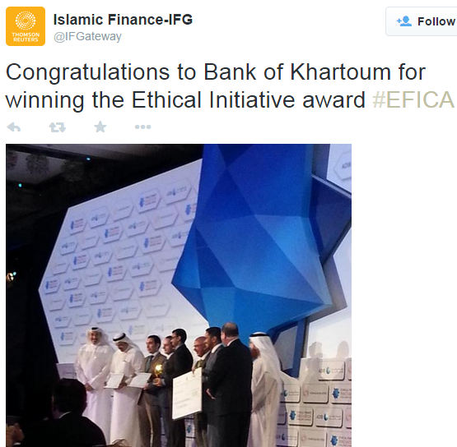
Irada implements iSHRAQ in Sudan

Slide 40
Thank You!
www.path-solutions.com

