Slide 1
A Case Study of Muslim Aid
Islamic Microfinance
Towards Economic Empowerment
Syed Khurram Khursheed Program Manager – Economic Empowerment & Livelihood Provincial Manager – Punjab Muslim Aid Pakistan
khurram@muslimaid.org.pk
A Case Study of Muslim Aid
Islamic Microfinance
Towards Economic Empowerment
Syed Khurram Khursheed Program Manager

Slide 2
INSTITUTION
Muslim Aid was founded in 1985
Our field offices
Bosnia, Iraq, Sudan, Somalia, Pakistan, Sri Lanka, Indonesia, Bangladesh, Cambodia, The Gambia, Lebanon
Regional Coordination Offices
Kenya, Jordan
We provide reliefs and development programmes in over 70 countries.
The Muslim Aid liaison office Pakistan was upgraded to a fully equipped field office Pakistan in 2005 in response to the earthquake.

Slide 3
Thematic Areas
WASH
Health
Education
Microfinance
Skills Development
Livelihood
Child Development
Humanitarian Response
Seasonal Programs

Slide 4
Facts & Background
Nearly 1/2 of the world’s population — more than 3 billion people — live on less than $2.50 a day. More than 1.3 billion live in extreme poverty, that's less than $1.25 a day.
80% of the world population lives on less than $10 a day
900 million extremely poor people live in rural areas in developing countries.
48 million people are living below poverty line of 1$ per day in Pakistan
Despite all development efforts over 60 years, the gap between the poor and the rich is widening.
The poor are denied to have access to the formal finance institutions simply because they are unbankable.
Notes:
4

Slide 5
Need of Microfinance ?
One of our goals is to make a significant contribution to the alleviation of world poverty by 2015
Poverty is multi dimension and Microfinance is one of the powerful tool to fight poverty.
When poor people have access to financial services, they can earn more, build their assets, and cushion themselves against external shocks.
Poor households use microfinance to move from everyday survival to planning for the future: they invest in better nutrition, housing, health, and education
Notes:
5

Slide 6
Microfinance
In this program, our aim is to expand the coverage and outreach of our support by focusing on vulnerable families for whom economic empowerment is critical for survival.
We are pursuing a structured need identification and assessment process for improved accountability, orient families about our Shariah compliant microfinance package and ensure that assistance provided brings about a change in the quality of life of the assisted families.
Notes:
6

Slide 7
Strategic Objective
Expand coverage and outreach of Shariah compliant microfinance initiatives for economic empowerment to 10,000 more families in next two years in Pakistan specifically and 100,000 families in general to other different Muslim Aid country offices i.e.. Bangladesh, Sri Lanka, Afghanistan, Syria, Cambodia, Bosnia and Indonesia.
Notes:
7

Slide 8
MEDP (Micro Enterprise
Development Program)
People living in poverty, like everyone else, need a diverse range of financial instruments
MEDP was started in March 2008 in Chakwal and August 2011 in Rawalpindi.
Main objectives of the project were to create awareness about enterprises development, provide technical assistance in enterprise development and provision of micro credit (On Murabaha, a shariah compliance mode) for establishment or enhancement of micro enterprises.
Notes:
8

Slide 9
Qard-e-Hasana
We have started a joint project of Qarde Hasana with Akhowat on 1st June, 2007 in Sadiqabad, Rawalpindi, with the objective of providing interest free credit to the poor so as to enhance their standard of living.
Notes:
9

Slide 10
Muslim Aid Islamic Microfinance Salient Features
Unique: Shari’a compliant, social mission, Pro-poor
Comprehensive: diverse products with a variety of flavours designed for all financial needs of poor and low income people
Integrated: integrated with development programme such as skills development centres
Notes:
10

Slide 11
Continue…..
Sustainable: Initiated and designed a way in which both financial sustainability of the programme as well as beneficiary sustainability will be highly achieved
Inclusive: Financial services will be provided to all – poor, and low income people
Outreach: The programme will serve masses and also increase its outreach from time to time.
Proper Management and Information System: The programme is guided by internal management system, programme performance standard, proper reporting, monitoring and evaluation system & impact assessment.
Notes:
11

Slide 12
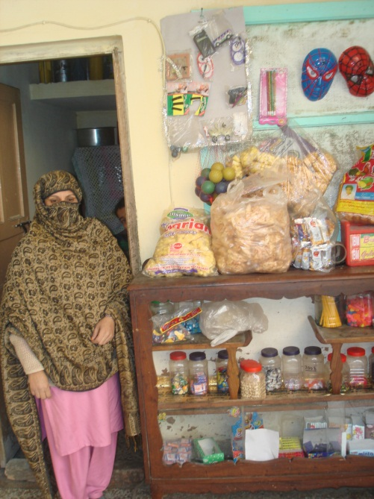
Products Features
Shariah Compliant Products
Focused on Micro-enterprises
Micro-Credit (Murabaha)
Shariah Compliant – Strictly In-Kind
For Micro-enterprises establishment and enhancement
No physical collateral
Upto Rs 30,000
Return in Monthly installment
Establishment of new micro-enterprises
Enhancement of micro-enterprises
Notes:
12

Slide 13
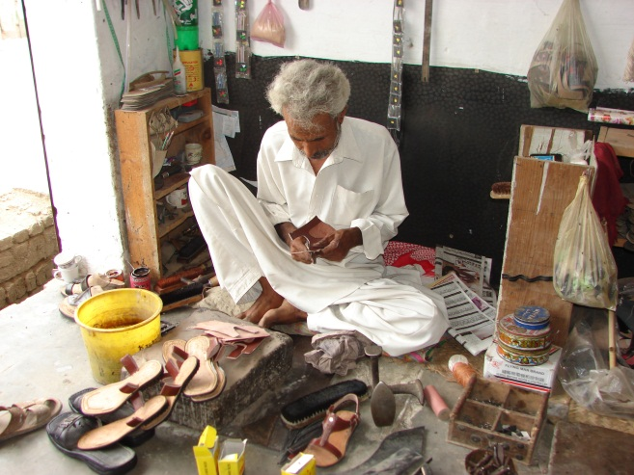
Products Features
Qarde Hasana
For poorest of the poor
For starting micro-enterprises
Liberation loan
No physical collateral
Easy processing
Average Loan size Rs 15,000
Return in easy monthly
installments
Notes:
13

Slide 14
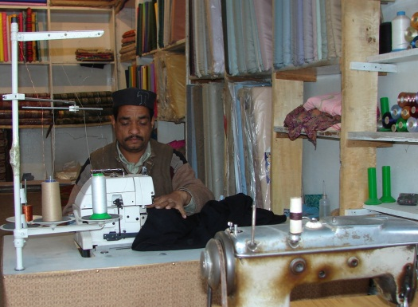
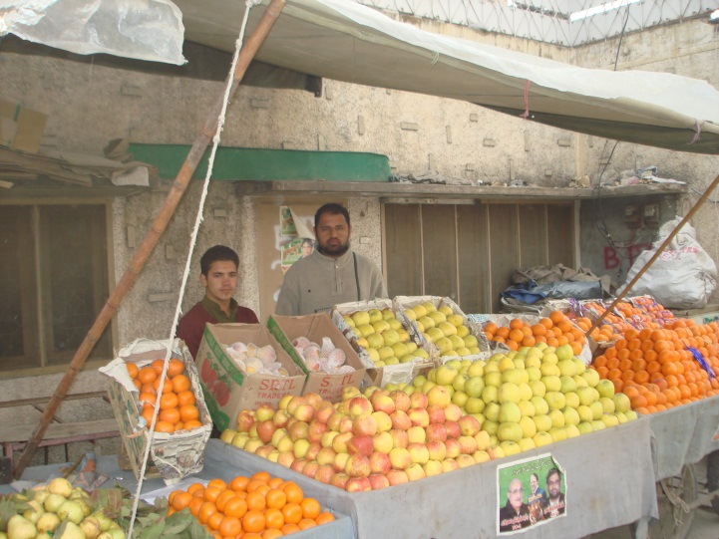
Our Standings
Total Disbursement till
date Rs 9’39’24’195
Total Clients till date, micro
enterprises established/enhanced
6,174
Total Outstanding in the
market 1’39’42’091
Total active clients 1,225
Recovery percentage 98%
Notes:
14

Slide 15
Islamic Microfinance
OPPORTUNITIES
CHALLENGES
Provide access to credit to many of the poor in Muslims Countries
Needs to include Business Development Services
Asset-based mode of financing can prevent diversion of funds for consumption
Need to develop a uniform regulatory and legal framework for the Islamic Finance system
Islamic finance can resolve the Moral Hazard problem
Lack of qualified manpower
Musharaka and Mudaraba are more attractive to SMEs
Murabaha generates high initial transactions costs

Slide 16
Conclusion
Diverse approaches are needed- making this a reality entails breaking down the walls real and imaginary that currently separate microfinance from the much broader world of financial systems.
In the context of poor people in Muslim societies, building inclusive financial systems would most certainly require integration of microfinance with Islamic finance.
Cultural and religious sensitivities of the Islamic world are somewhat unique and these must be given due emphasis in any attempt to build inclusive financial systems and bring the over one-billion Muslims into the fold of formal financial systems.
We need to make people sustainable rather habitual of financial support.
Change factor is so important, without behaviour change we can’t win.

Slide 17
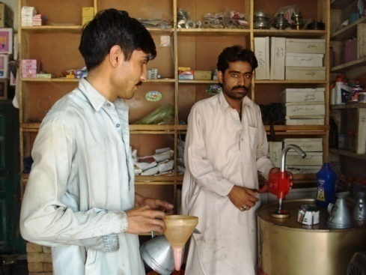
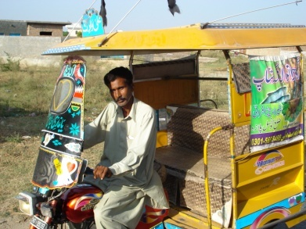
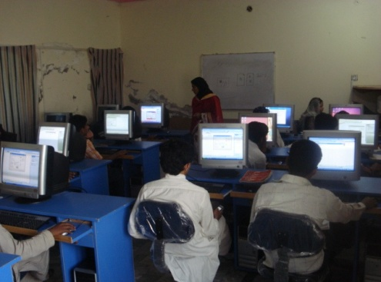
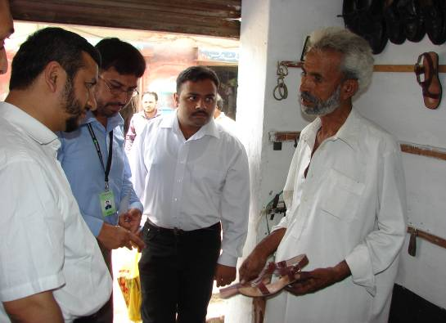
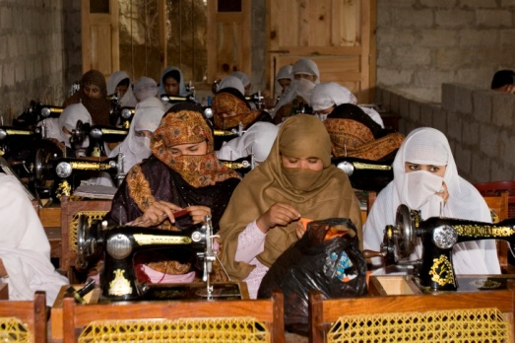
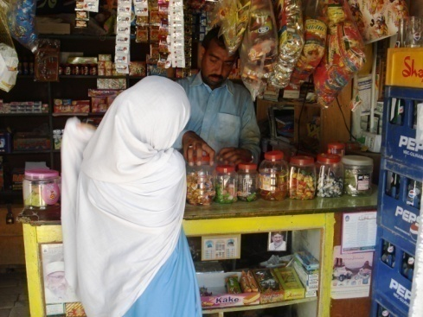
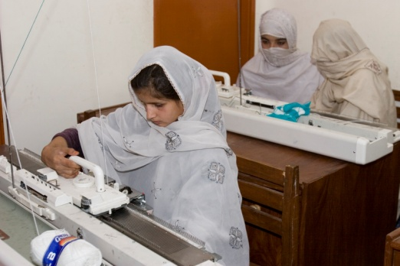
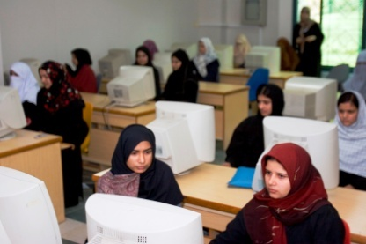
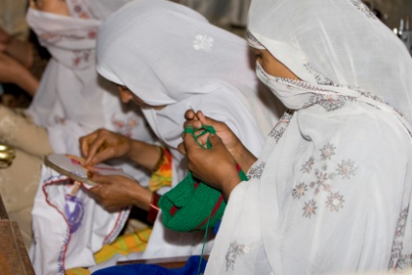
ECONOMIC EMPOWERMENT

Slide 18
Together we can make the difference
Join Hands to make the difference NOW…. Any Questions………
Thank You……….

