Slide 1
Islamic Microfinance as an Important
Tool of Poverty Alleviation
Muhammad Zubair Mughal
Chief Executive Officer
Allhuda centre of Islamic banking and economics

Slide 2
Contents
Basic Principles of Islamic Microfinance
Source of Islamic Micro Finance Product Products
Compatibility of IMF Products with Conventional Microfinance Models
Islamic Microfinance Products
Need Assessment of Islamic Microfinance
Opportunities & Challenges Faced by IMF Sector

Slide 3
Basic Principle of Shariah Based Banking & Microfinance
Prohibition of Interest.
Care for the poor is a religious obligation in Islam.
Asset Based Financing
Risk Sharing
Sanctity of contracts
Financing in Halal/Shariah Complaint Activities.
Prohibition of speculative behaviour ( Gharar).
Micro Takaful ( Micro Islamic Insurance)
“Assisting the poor is a pillar of Islam”

Slide 4
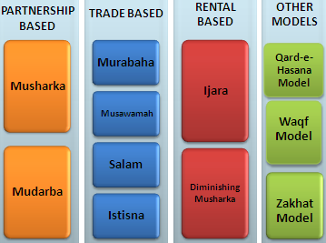
Source of Islamic Microfinance Product
Sources of Islamic Finance
Islamic Banking & Microfinance Product Mechanism
Quran
Sunnah
Ijma’a (jurist consensus)
Ijtihad & Qiyas (analogy)

Slide 5
Islam and Shariah
Notes:
Source: Institute of Policy Studies

Slide 6
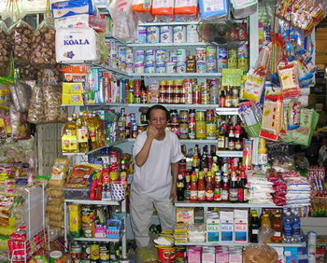
Islamic Microfinance Products
Murabahah – Cost Plus Sale
Literally it means a sale on mutually agreed profit, also known as cost plus sales, it is one of the most widely used instruments for short-term financing where the MFI undertakes to supply specific goods or commodities at mutually agreed profit to the client.
Utilization :
Murabahah can be utilize for Purchase of raw materials, equipment, agri. Inputs, Consumer goods, Vehicle, Houses etc..
Currently Practiced:
AlBaraka Bank, Al Amal Bank, HSBC, Amanah
Islamic Bank,Islamic Bank Bangladesh, FINCA-AF,
Islamic Relief, BMT’s in Indonesia etc.

Slide 7
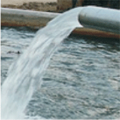
Islamic Finance Products for Halal Industry
Salam – Forward Sale
Salam means a contract in which advance payment is made for goods to be delivered later on. The seller undertakes to supply some specific goods to the buyer at a future date in exchange of an advance price fully paid at the time of contract
Utilization in Halal Industry:
Salam is ideal product for Agricultural Financing, it can also utilize for other business purposes as well.
Currently Practiced:
CWCD, Albarakah MPCS,

Slide 8
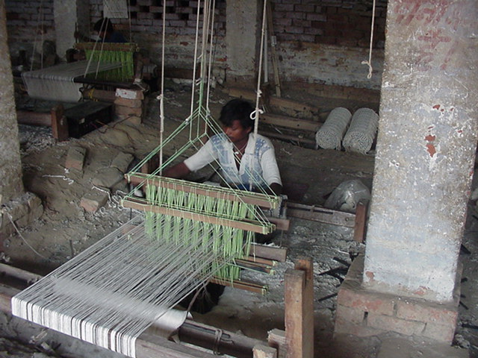
Islamic Microfinance Products
Istisna - Manufacturing contract
A pre-delivery financing instrument used to finance projects where commodity is transacted before it comes into existence. It is an order to manufacture and payment of price, unlike Salam, it’s flexible, where price may be paid in advance, or in installments or on delivery of good.
Utilization:
Istisna May Utilize for small manufacturing Business, for production use, Micro entrepreneur Development sectors etc.
Currently Practiced:
Meezan bank, Ghana Islamic Microfinance bank,
DIB, MayBank, Standard Chartered etc.

Slide 9
Islamic Microfinance Products
Musharaka - Partnership
Musharakah means a relationship established under a contract by the mutual consent of the parties for sharing of profits and losses in the joint business.
Utilization :
Musharka can be used for Microenterprise & SME’S setup’s, Small productive projects, Working capital financing
Currently Practiced:
CIMB, Amanah Islamic bank, AlBarakah, DIB,
etc

Slide 10
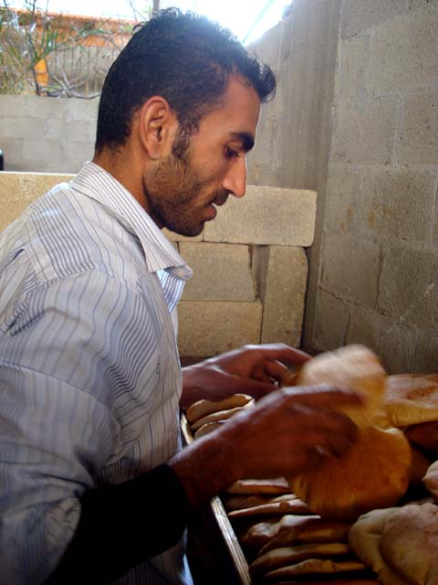
Islamic Microfinance Products
Mudaraba - Partnership
A trustee-type finance contract under which one party (MFI) provides the capital for a project and the other party ( Client) provides the labor/Skill. Profit sharing is agreed between the two parties on mutual consent but the losses should be borne by the provider of funds .
Utilization:
Small Business, Microenterprise setup’s, Small productive projects,
Working capital financing
Currently Practiced :
Bank of Khyber, Islamic Bank Bangladesh, CWCD,
Islamic Relief, Awqaf South Africa etc.

Slide 11
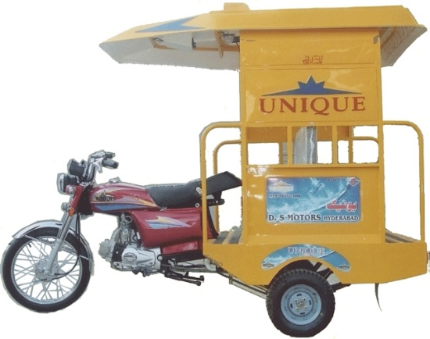
Products in Islamic Microfinance
Ijara – Islamic Lease
Ijarah Means Operating lease. It is an arrangement under which the Islamic Micro Finance Institution lease equipments, light Vehicles, Instruments, buildings or other facilities to a client, against an agreed rental.
Utilization :
Auto Financing, Equipment Financing, House
Lease, small production unit lease etc.
Currently Practiced:
Al-Amal Microfinance Bank, NRDP, CWCD etc.
Amanah Islamic Bank – Philippines.

Slide 12
Products in Islamic Microfinance
Diminishing Musharkah
Diminishing Musharkah is a form of Musharakah where the MFI and his client participate in a joint commercial enterprise or property. This attains the form of undivided ownership of both the financier and the client. Over certain period the equity of financier is purchased by the client
Utilization:
This is an ideal product for Housing Finance sector, but also utilize for other ventures as well.
Currently Practiced:
CWCD, Ariana Financial Services, Helping hands etc

Slide 13
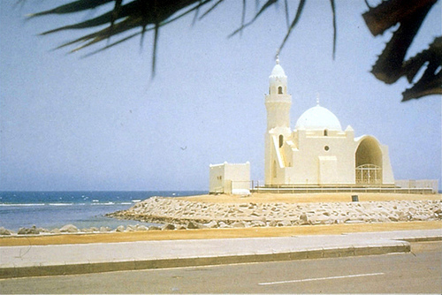
Products in Islamic Microfinance
Other Products
Qard-e-Hassana Model, Waqf Model, Zakhat Model, Cooperative Model, BMTs, Micro Takaful ( Islamic Micro insurance )
Utilization :
Qard-e-Hassana : for Emergency Loan, benevolence loan, Student, Maternity etc
Zakat : Health, Shelter, Safety net programs, Education and where Zakat applicable. MicroTakaful: Micro Risk Management, Crop & Livestock Insurance etc.
Currently Practiced
AIMS- Malaysia, Akhuwat, Awqaf South Africa ,
Al-Amal Microfinance bank, BMTs - Indonesia etc

Slide 14
Market for Islamic Microfinance Products
Salam, Istisna and other products
Non-Poor
Transitory Non-Poor
Transitory Vulnerable
Qarz-e-Hasan, Murabahah, Ijarah, Mudarabah
Transitory Poor
Chronic Poor
Zakat, Sadqa, Ushar
Extremely Poor
Notes:
In this slide we will learn that what islamic Microfinance Product will be ideal for what sector, We can categories poverty into Six level
14

Slide 15
Factors to be considered while doing Islamic Finance
Poverty Alleviation Element
and more….
Moral
Ethical
Social
A Misconception removed
Islamic Microfinance is a system not the Religion, it can be utilized & operated by both Muslims and
Non-Muslim Communities for Poverty Alleviation, Social & Economic Development.
Micro Takaful
Islamic
Micro
Finance
Free from Gharar
Free from Interest
Financing
Shariah Complaints Funds
Ensure Shariah Compliance
Trainings & Quality HR
Shariah Vetted Products
Shariah Complaints Investments

Slide 16
Demand for Islamic Micro Finance
Research Studies by International Institutions.
Survey by | Surveyed Countries | Respondents Preference (%)
CGAP 08 | Jordan, Algeria, and Syria | 20% - 40%
PlaNet Finance 07 | West Bank and Gaza | 35% - 60 %
USAID 02 | Jordan | 24.9%
IFC/FINCA 06 | Jordan | 32%
Frankfurt School of Fin & Mgmt 06 | Algeria | 20.7%
IFC sponsored Study | Yemen | 40%
IFC 2007 | Syria | 43%-46%
Bank Indonesia 2000 | Indonesia (East Java) | 49%
AlHuda-CIBE | Pakistan (4 Districts) | 99%

Slide 17
Islamic Microfinance Institution Worldwide
Germany:2
- Muslim Society
Switzerland: 2
UAE: 4
- Dubai Islamic Bank
- Abu Dhabi Islamic Bank
- HSBC Amanah
UK: 5
- HSBC Amanah
- Muslim Aid
- Islamic Relief
Faith Matters
- The Halal Mutual Investment Company
Kuwait: 2
- Kuwait Finance House
United States: 3
Helping Hands
ISNA
Lariba
Bahrain: 2
Family Bank
Afghanistan 9:
- FINCA , WOCCU
- CHF
Ariana
Iran: 8
Pakistan: 11
India: 3
Bangladesh:9
Turkey: 2
- Faisal Finance Institution
- Ikhlas Finance House
Egypt: 3
- Alwatany Bank of Egypt
- Egyptian Saudi Finance
Malaysia: 11
2 - Pure Islamic Banks (Bank Islam, Bank Muamalat)
Rest - banks
Sudan: 13
Yemen: 05
Al- Amal
Al Kuraimi
South Africa
Awqaf SA
IMFI’s Worldwide: 300 * in Countries: 32
Market Size: 1 billion USD
Indonesia: 133
BPRS , BMT.
Muaritius
AlBaraka MPCS

Slide 18
Some Islamic Microfinance Institutions - Worldwide
Countries | Islamic Microfinance Institutions
Indonesia | BPRS, Islamic Financial Cooperatives referred as bait Maal wat Tamwil (BMT)
Bangladesh | Islamic Bank Bangladesh, Social and Investment Bank, Al-Fallah and Rescue
Afghanistan | FINCA (Qard Hasan), WOCCU, Ariana Financial Services , IFIC, etc.
Pakistan | Akhuwat , Farz Foundation, ASASAH, Muslim Aid, Islamic Relief, CWCD, ,HHRD , NRSP, NRDP, Naymet etc.
Malaysia | Amina Iftikhar, Tabung Haji etc
India | AICMEU, BASIX, Sahulat, Bait-un-Nasr , Al-Khair Co-operative, Marwar Shariah Credit
Egypt | Mit Ghamar Project
Syria | Sanadiq project Jabal al Hoss
Lebanon | Mu’assat Bayat Al-Mal
Yeman | Hodeidah Microfinance Program, Al-Amal Microfinance Bank etc.
South Africa | Awqaf South Africa
U.K | Faith Matters, Islamic Relief, Muslim Aid, HSBC Amanah etc.
Tanzania | Hajj Trust, Four SACCOS

Slide 19
Compatibility IMF Products with MF Models
Grameen Model: Amna Iftikhar – Malaysia, Islami Bank Bangladesh Limited etc.
Village Bank Model: Sanadiq program -Jabal al-Hoss, Syria, FINCA - Afghanistan etc.
Credit Union Model: Muslim Credit Union (Tobago), The Amwal Credit Union etc.
Cooperative Model: AlBaraka MPCS – Mauritius, Al- Khair Coop. – India, Muslim Community Coop.– Australia, Karakorum Cooperative Bank – Pakistan.
Self-Help Group: Aameen Society - India
For Profit Banks/MFIs Ghana Islamic Microfinance Banks – Ghana, HSBC Amanah – U.K, Bank Islami - Pakistan

Slide 20
Current Status of Islamic Finance Industry
Total market size1.6 Trillion USD with having 1500+ Islamic Financial Institutions
In 81 Countries, among them 42 are Islamic and 39 are Non Islamic Countries.
250+ Takaful companies
750+ Islamic Funds are operating globally.
300+ Sukuk has been issued.
Big Potential in African Countries.

Slide 21
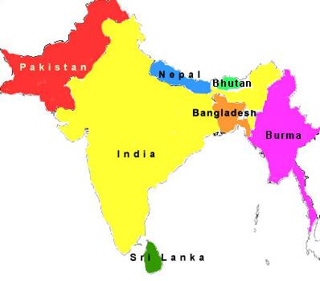
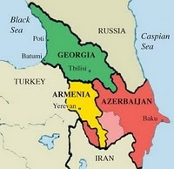
Need Assessment of Islamic Microfinance for
Central Asia, the Caucasus, and South Asia
Central Asia
South Asia
Caucasus
Countries | * Muslim Population | %
Kazakhstan | 8,887 | 56.4
Kyrgyzstan | 4,927 | 88.8
Tajikistan | 7,006 | 99.0
Turkmenistan | 4,830 | 93.3
Uzbekistan | 26,833 | 96.5
Aggregate | 52,483 | 85.5%
Countries | * Muslim Population | %
Bangladesh | 148,607 | 90
Bhutan | 7 | 1
India | 177,286 | 14.6
Maldives | 309 | 98.4
Nepal | 1,253 | 4.2
Pakistan | 178,097 | 96.4
Sri Lanka | 1,725 | 8.5
Afghanistan | 29,047 | 99.8
Aggregate | 536,331 | 33.2%
**Countries | * Muslim Population | %
Armenia | 1 | <0.1
Azerbaijan | 8,795 | 99.2
Georgia | 423 | 9.9
Stavropol Krai | - | -
Krasnodar Krai | - | -
Aggregate | 9,219 | 70%
* According to 2010-11 & .in figure 000 ** Appropriate data is not available for North Causasus
Notes:
Lets take a glimpse of Need Assessment of Islamic Microfinance for Central Asia, the caucasus and South Asia. In Central Asia we are seeing a big Muslim Popoultaion. In Central Asia………….
This concludes a great potential and requirement for Islamic Microfinance in these regions
http://en.wikipedia.org/wiki/South_asia
http://en.wikipedia.org/wiki/Central_Asia

Slide 22
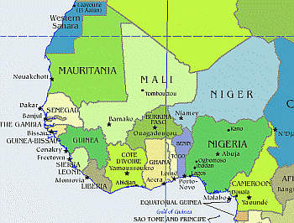
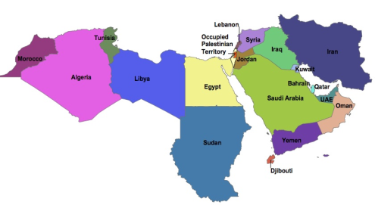
Need Assessment of Islamic Microfinance for
West Africa and MENA Region
West Africa
MENA Region
(Middle East & North Africa Region)
Countries | * Muslim Population | %
Benin | 2,259 | 24.5
Burkina Faso | 9,600 | 58.9
Cape Verde | < 1 | 0.1
The Gambia | 1,669 | 95.3
Ghana | 3,906 | 16.1
Guinea | 8,693 | 84.2
Guinea-Bissau | - | -
Liberia | 523 | 12.8
Mali | 12,316 | 92.4
Mauritania | 3,338 | 99.2
Niger | 15,627 | 98.3
Nigeria | 75,728 | 47.9
Senegal | 12,333 | 95.9
Sierra Leone | 12,333 | 95.9
Senegal Sierra | 12,333 | 95.9
Togo | 827 | 12.2
Aggregate | 171,485 | 57.8%
Countries | * Muslim Population | %
Algeria | 34,780 | 98.2
Bahrain | 655 | 81.2
Egypt | 80,024 | 94.7
Iran | 74,819 | 99.6
Iraq | 31,108 | 98.9
Jordan | 6,397 | 98.8
Kuwait | 2,636 | 86.4
Lebanon | 2,542 | 59.7
Libya | 6,325 | 96.6
Morocco | 32,381 | 99.9
Oman | 2,547 | 87.7
Qatar | 1,168 | 77.5
Saudi Arabia | 25,493 | 97.1
Syria | 20,895 | 92.8
Tunisia | 10,349 | 99.8
UAE | 3,577 | 76.0
Yemen | 24,023 | 99.0
Aggregate | 359,719 | 97.3%
* According to 2010-11 & .in figure 000

Slide 23
Need Assessment of Islamic Microfinance
Approximately 46% conventional microfinance clients worldwide reside in Muslim countries
Almost one-half of the 56 IDB member countries in Asia and Africa are classed as United Nations Least Developed Countries (LDCs),
Islamic Asset-based Financing – can prevent diversion of funds for consumption.
Islamic Microfinance have proven track record that its deals with long lasting & Complete solutions for Sustainability.
Halal Industry need funding for SME and Micro set-ups

Slide 24
Need of Islamic Microfinance in Africa
54% Muslim Population in Africa which will be 60% in next 15 years.
Extreme Poverty in African Countries, Especially Muslim Majority Countries.
Insufficient Product Range as comparatively of Islamic Microfinance
Conventional product Performance
Commercialism in Microfinance.

Slide 25
Challenges faced by Islamic Microfinance
Non - Availability of Donor/Shariah Compliant Sources of Funds
Need to develop a uniform regulatory and legal framework for the Islamic Microfinance Institutions.
Accounting & I.T systems., Rating Agencies.
Lack of Quality HR in Islamic Microfinance Sector.
Standardization of Islamic Microfinance Products.
Reluctance in Research & Implementation of new Products, as only (Murabahah) is serving almost 80% of Islamic Microfinance Industry.
Development of Shairah Expertise towards the Growth of Islamic Microfinance.
Policies & Regulations on Zakat & Awqaf.

Slide 26
Opportunities for Islamic Microfinance
International Islamic Microfinance Network (IMFN) for an effective interface and Coordination among IMFI’s
Expansion of Market where the Conventional MFI’s face limitations especially in Muslim Majority Countries
AlHuda Centre of Excellence in Islamic Microfinance is offering all Islamic Microfinance Solution.
A Trend in diversion of donors funds to more ethical objectives
IDB - Microfinance Development Program (MDP )
Islamic Banking and Finance is emerging in South Asia, Central Asia & MENA region which will strengthened the Islamic Microfinance effectively.

Slide 27
Conventional banking | Islamic banking
Functions and operations are based on fully man made principles | Functions and operations are based on Sharia’h principles
Investor is assured of pre-determined rate of interest | Promote risk-sharing between provider of capital (investor) and user of funds (entrepreneurs)
Aim at maximising profit without any restrictions | Aim at maximising profit but subject to Sharia'h restrictions
Creditor-Debtor relationship | Partners, investor and traders, buyer or seller relationship
Based on money trading. Money is a medium of exchange and not a commodity | Encourage asset-based financing and based on commodity trading & Services

Slide 28
Conventional banking | Islamic banking
It is almost risk free banking and depositor has no risk of losing its money because interest is guaranteed. | No right of profit if there is no risk involved. The profit and loss sharing depositor may lose money in case of loss.
It can charge additional money in case of defaulters | Islamic banks have no provision to charge any extra money from the defaulters
Very often it results in the banks own interest becoming prominent. it makes no effort to ensure growth with equity | It gives due importance to the public interest, its ultimate aim is to ensure growth with equity
Do Deal in Zakat | Deal in Zakat ( Non Muslim Countries )

Slide 29
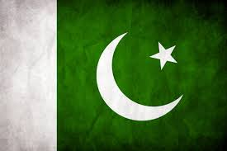
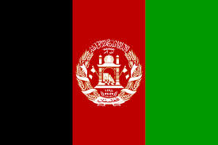
Selected Asian Countries
Pakistan
Afghanistan
Indonesia
Yemen
Notes:
Pakistan, officially the Islamic Republic of Pakistan, is a sovereign country in South Asia. With a population exceeding 180 million people, it is the sixth most populous country and with an area covering 796,096 km² - Muslim Population 178 m (2010) estimated
Afghanistan, officially the Islamic Republic of Afghanistan, is a landlocked country located in Central Asia, South Asia, and is a part of the Greater Middle East – Muslim Population 29 m (2010) estimated
Indonesia, officially the Republic of Indonesia, is a sovereign state in Southeast Asia and Oceania and comprising approximately 17,508 islands – Muslim Population 204 m (2010) estimated
Yemen, officially known as the Republic of Yemen, is an Arab country located in Western Asia. Yemen is the second largest country in the peninsula, occupying 527,970 km² - Muslim Population 24 m (2010) estimated

Slide 30
Some Islamic Microfinance Institutions - Asia
Countries | Islamic Microfinance Institutions
Pakistan | Akhuwat , Farz Foundation, ASASAH, Muslim Aid, Islamic Relief, CWCD, ,HHRD , NRSP, NRDP, Naymet etc.
Afghanistan | FINCA , WOCCU, Ariana Financial Services , IFIC, Islamic Relief etc.
Indonesia | BPRS, Muslim Aid, Islamic Financial Cooperatives referred as bait Maal wat Tamwil (BMT) etc.
Yemen | Hodeida Microfinance Program, Al-Amal Microfinance Bank etc, Al Kurumi Microfinance etc.
Notes:
Here we have the country wise detail of some Islamic Microfinance Institutions worldwide.

Slide 31
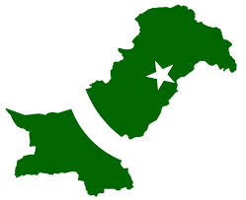
Pakistan – South Asia
Population - 180 million
Muslim population - 97%
GDP – USD 225.1 billion
Per Capita Income – USD 1260
Category – Lower Middle Income
Poverty Rate – 22.3% (less than USD 1.25/ per day)
Microfinance Industry – Developing
Lack of Funding (Least interest of Donors) in Islamic microfinance while demand of Islamic Microfinance is rising
Source: World Bank (website)

Slide 32
Pakistan & Islamic Microfinance Industry
Institution | Islamic Microfinance Products
Akhuwat | Qaraz-e-Hasna, MicroTakaful, Grants
Farz Foundation | Murabaha, Musharakah, Livestock
Asasah | Mudaraba, Musharaka
Muslim AID | Murabaha
Islamic Relief | Murabaha and Qarz-e-Hassan
CWCD | Murabaha, Ijarah, Salam & Istisna MicroTakaful
HHRD | Murabaha, Mudarabah
NRDP | Qard-e-Hasana, Murabaha
NRSP | Murabaha - Mudarabah with BOK for funding Source
Naymet | Qard-e-Hasana
Operation Cost: 10 - 25%

Slide 33
Pakistan & Islamic Microfinance Industry
Innovation:
Micro Takaful
IT Integration (Mobile Banking) in Islamic Microfinance
Livestock Product with Islamic Microfinance operation
Micro energy & Micro Saving products
Challenges:
Unavailability of Shariah Compliant fund
Reluctance of Donor Agencies for Islamic Microfinance
Accounting & I.T systems., Rating Agencies.
Law and order in Northern part of Pakistan
Future Prospects:
Rapid growth of IMFIs with high acceptability from the Muslim community.
Govt. Interest and IDB Support
AlHuda Centre of Excellence in Islamic Microfinance

Slide 34
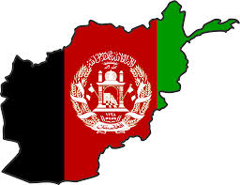
Afghanistan - South Asia
Population - 29.82 million
Muslim population - 100%
GDP – USD 20.50 billion
Category - Low Income
Per Capita GNI – USD 680
Poverty Rate – 36% (less than USD 1.25/ per day)
Microfinance Industry – Developing
Donors – MISFA, USAID, IFC etc
High Demand of Islamic Microfinance
Source: World Bank (website)

Slide 35
Afghanistan & Islamic Microfinance Industry
Institution | Islamic Microfinance Products
FINCA | Murabaha
WOCCU | Murabaha, Mudaraba and Ijara
Ariana Financial Services | Murabaha, Qarz-e-Hassan
Islamic Relief | Murabaha, Qarz-e-Hassan
IIFC, HIH | Murabaha, Qarz-e-Hassan
Islamic Bank with Microfinance Operation | Murabaha, Mudaraba and Ijara
Operational Cost: 20% - 30%

Slide 36
Afghanistan & Islamic Microfinance Industry
Innovation:
Enterprise Incubation i.e. business modeling and micro financing.
Integration of Rural Economy (Exact Target Market) with Islamic Microfinance
Challenges:
Lack of Quality HR in Islamic Microfinance Sector Poor IT integration
Weak microfinance regulatory regime.
Unavailability of Micro Insurance
Security, Law and order
Future Prospects:
Rising Donors’ interest for poverty alleviation (FINCA, HIH, MISFA & USAID etc)
High demand of Islamic Microfinance

Slide 37
Indonesia – East Asia and Pacific
Population – 246.9 million
Muslim population - 88%
GDP – USD 878.0 billion
Category – Developing (Lower Middle Income)
Per Capita GNI – USD 3420
Poverty Rate – 12% (less than USD 1.25/ per day)
Microfinance Industry – Developing
High Demand of Islamic Microfinance
Source: World Bank (website)

Slide 38
Indonesia & Islamic Microfinance Industry
Institution | Islamic Microfinance Products
BPRS, BMT’s | Murabahah, Ijarah, Musharaka etc.
Muslim Aid | Murabaha
WAFA | Murabahah
Operational Cost: 15 - 25%

Slide 39
Indonesia & Islamic Microfinance Industry
Innovation:
Bait-ul-mal Tamveel (BMT), BPRS
Challenges:
Poor IT integration
High Poverty Index
Lesser financial sustainability in the community/ natives
Future Prospects:
Rising Donors’ interest poverty alleviation especially through IMF
Role of Ministry of Cooperative & Central Bank is positive.
Rapid growth of IMFIs with high acceptability from the majority Muslim community.

Slide 40
Yemen – Middle East and North Africa
Population – 23.85 million
Muslim population – 100%
GDP – USD 35.65 billion
Category – Developing (Lower Middle Income)
Per Capita GNI – USD 1270
Poverty Rate – 34.8% (less than USD 1.25/ per day)
Microfinance Industry – Developing
High Demand of Islamic Microfinance
Source: World Bank (website)

Slide 41
Yemen & Islamic Microfinance Industry
Innovation:
I.T Integration & Micro Takaful
Role of Islamic Bank to Strengthened the Islamic Microfinance Institutions.
Challenges:
Reluctance in Research & Implementation of new Products, as only (Murabahah) is serving almost 80% of Islamic Microfinance Industry.
Significant division of Urban and Rural population
Law and Order
Future Prospects:
High Demand of IMF
Role of SFD & YMN
New Range of Islamic Microfinance products

Slide 42
JazzakAllah Thank you for listening with patience
Muhammad Zubair Mughal
Chief Executive Officer
AlHuda Centre of Islamic Banking and Economics
Zubair.mughal@alhudacibe.com
www.alhudacibe.com

