Slide 1
Housing Finance – Market, Opportunities and Challenges

Slide 2
Affordable Housing
Affordable housing is a term used to describe dwelling units whose total housing costs for either rented or purchased unit, are deemed affordable to those that have a median household income.
In the United Kingdom affordable housing includes "social rented and intermediate housing, provided to specified eligible households whose needs are not met by the market."

Slide 3
Socio-Economic Impact of Affordable Housing
Housing sector has important forward and backward linkages in terms of socio-economic development.
Social
Supply of affordable housing has major impact in terms of improving living conditions, health, education and human development.
Economic
Development of Housing and Real Estate Sector has a direct impact on GDP growth, growth of Financial Sector, Construction Material Industry, Employment, Capital Market as well as Insurance Industry.

Slide 4
Some of the areas addressed by decent housing amongst the low income families include:
A family with a decent and durable house is a confident family to participate in community development including enterprise development;
Children, especially those below 5 years old, are prone to few preventable diseases hence providing their parents, particularly mothers, to participate in other income generating activities;
Decent houses are well ventilated and lit hence provide opportunities for school children to study and do their homework while at home which contributes to improvement in education standards and
A family that owns a house is able to provide good protection to the girl child by ensuring that safe bedrooms are availed

Slide 5
Rapid Urbanization - Highlights
Urbanization (2008)
Total Population: >170 m
Urban Population: >60 m (36%)
Annual growth rates (2005-2010)
National: 1.8%
Urban: 3%
Major Cities (2008)-Concentration
Karachi: 12.4 m
Lahore: 6.7 m
Faisalabad: 2.6 m
Islamabad/Rawalpindi: 2.5 m
Source: UN DESA
Slum indicators
Slum to urban population: 48.9%
Source: UN-HABITAT 2005

Slide 6
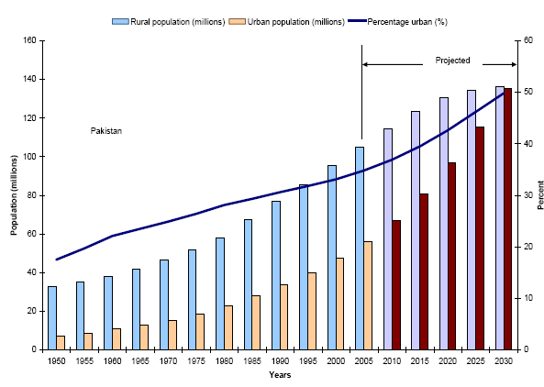
Projected Urban & Rural Population

Slide 7
Housing Needs in Pakistan
Market Scenario
In a 2009 report, World Bank estimated a Housing Shortfall of around 8 million units in Pakistan
ABAD claims annual incremental demand of 600,000 units of which 50% is met by the private/public investment leaving an annual shortfall of 300,000 units
Taking 600,000 incremental demand and 500,000 units from the backlog, total annual housing needs come to 1.1 million
At an average price of Rs. 1 million per unit, total funding requirement is Rs 1.1 trillion per year
Assuming that only 10% of housing needs can be converted into effective demand, total funding needs are Rs.110 billion
At 70% LTV (Loan–to-Value Ratio), this translates into Rs. 77 billion per annum housing credit requirement

Slide 8
Efforts/Key Initiatives for Housing in Pakistan
House Building Finance Company Limited
National Housing Policy 2001
National Housing Authority/Pakistan Housing Authority
Prime Minister Housing Schemes
Formation of Housing Advisory Group by SBP
Initiatives by Provincial Governments
Private Sector Initiatives

Slide 9
Housing Finance
No. of Institutions involved in Housing Finance
Commercial Banks : 22
Islamic Banks : 05
DFIs : 02
MFBs : 02
Islamic Banking Branches : 07
Product Range
Construction
Outright Purchase
Renovation

Slide 10
Mortgage Market of Pakistan
Gross Outstanding
Non-performing loans

Slide 11
Islamic Banking Industry
Gross Outstanding Islamic Banking Industry (Rs. Billions)
Non-performing assets (Rs. Billions)

Slide 12
Microfinance Banks
Gross Outstanding Microfinance Banking Industry (Rs. Millions)
Non-performing assets (Rs. Billions)

Slide 13
Role of SBP in Promotion of Housing Finance
Formation of Housing Advisory Group
Implementation of HAG recommendations
Development of secondary mortgage market in Pakistan by creating a Mortgage Refinance Company (MRC)
Review of Prudential Regulations for Housing Finance
Preparation of Housing Finance Guidelines
Development of a Model for Builders/Developers Finance
Capacity Development of Financial Institutions in housing finance through seminars, workshops and training programs
Effective coordination with key Stakeholders – ABAD, AMB etc

Slide 14
Housing Advisory Group-Recommendations
SBP formulated a Housing Advisory Group (HAG), drawing membership from different stakeholders and its recommendations are being actively pursued by SBP.
Reforming Legal Framework affecting Foreclosure, Transfer, Tenancy, Rent Control and Credit bureaus etc
Rationalization of Transaction Costs
Establishing an integrated land registration information system
Increasing supply of land for affordable housing
Structuring and streamlining Large Scale Developer’s Finance
Facilitate low-cost/low-income housing models and products
Facilitate Real Estate Investment Trusts (REITs)
Provision of long term funding for housing loans
Housing Observatory (housing market information system)
Capacity building of the mortgage banking industry in Pakistan

Slide 15
Mortgage Refinance Company
Develop the Primary Mortgage Market
Provide financial resources to enable primary mortgage lenders (PMLs) to grant more loans at fixed/hybrid rates and for longer tenure
Prepare PMLs for BASEL compliance by narrowing the gap between the maturity structure of the housing loans and the source of funds
Ensure loan standardization across primary lending institutions which is necessary for any future securitization
Develop the Capital Markets
Provide more private debt securities (Bonds) with different maturities and rates for investment of surplus funds
Promote ABS as a tool for raising funds from the capital markets
Create a Yield Curve to serve as a benchmark for other institutions

Slide 16
Housing Finance Regulations & Guidelines
Regulations
The Housing Finance regulations are covered under Consumer Finance Prudential Regulations.
Since Housing Finance has its distinct nature and scope, there has been growing demand from all stakeholders to separate Housing Finance from Consumer Finance.
SBP intends to announce reviewed Housing Finance Prudential Regulations this year.
Guidelines
Comprehensive set of Mortgage Finance Guidelines covering all facets of Housing Finance (Conventional and Faith-Based) based on best lending practices.
With active involvement of Association of Mortgage Bankers and feedback from other Stakeholders, these Guidelines would be launched this year.

Slide 17
Large Scale Builders Finance Model
SBP is working to develop financing models to facilitate large-scale builders/developers’ access to formal financial sector.
The Association of the Builders and Developers (ABAD), Investment Bankers, Association of Mortgage bankers (AMB) and Rating Agency have been consulted for the purpose.
Key challenges include:
Corporatization of large-scale developers
Bankable financial statements
Credit rating (Entity and Instrument Ratings)
Fiscal issues relating to Book Value and Market Value, declared income and wealth etc.

Slide 18
Models of Affordable Housing
Khuda Ki Basti
Ansar Management Company
Ashiyana

Slide 19
Khuda Ki Basti (KKB)
Incremental Development Approach
Immediate Possession
Construction as per the dwellers affordability, usually starts with Jhugi (Camp).
Development of Infrastructure Incrementally
Dweller has to provide proof of residency for the first five years to get the lease of land.

Slide 20
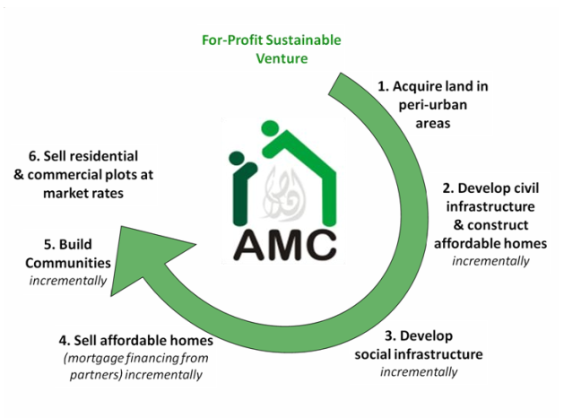
Ansar Management Company- Ctd…

Slide 21
Aashiyana Scheme -Govt. of Punjab
Objectives
Increase and improve the supply of housing, available and affordable to low and moderate income groups
Establishment of a sustainable community living
Ensuring decent and modern ambiance in each housing scheme
Bringing down the cost of the houses while not compromising on the quality
Making the project affordable for the target groups through easy installment plans
Ensuring transparency and fair play at every step

Slide 22
Aashiyana Scheme –Ctd…
Eligibility
Target Population will be individuals having income less than Rs. 20,000 p.m.
Monthly Installment of the allotted house not to exceed the monthly rent of same size of house.
Speculation will be curbed at all cost.
Special quota for widows, orphans and disabled.
Nuclear Family
Age between 25 & 60 years. (Applicable for bank loan only)
Living in a rented house or in joint family, the applicant should not posses his/her own house.
Physical verification of the credentials of each applicant through third party

Slide 23
Key Challenges & Way Forward
Key Challenges
High cost of land in metropolitan cities hinders affordable housing
Urban infrastructure up-gradation,
Single window clearance for approvals
Investment in low-cost building technology,
Investment linked tax incentives for developers to increase the supply of affordable housing
More effective public private partnerships to tackle the shortage of housing especially in the low income group
Deepening of the debt market to ensure availability of long-term funding
Development of new funding instruments
Way Forward
Exploration of Credit lines for Institutions offering Housing Finance
Promotion of Microfinance Banks to support borrowers with undocumented income
Establishment of a Housing Observatory

Slide 24
Thank you

Slide 25
Affordable Housing
Affordable housing is a term used to describe dwelling units whose total housing costs for either rented or purchased unit, are deemed affordable to those that have a median household income.
In the United Kingdom affordable housing includes "social rented and intermediate housing, provided to specified eligible households whose needs are not met by the market."

Slide 26
Areas addressed by decent housing amongst the low income families:
A family with a decent and durable house is a confident family to participate in community development including enterprise development;
Children, especially those below 5 years old, are prone to few preventable diseases hence providing their parents, particularly mothers, to participate in other income generating activities;
Decent houses are well ventilated and lit hence provide opportunities for school children to study and do their homework while at home which contributes to improvement in education standards and
A family that owns a house is able to provide good protection to the girl child by ensuring that safe bedrooms are availed

Slide 27
Efforts/Key Initiatives for Housing in Pakistan
National Housing Policy 2001
National Housing Authority/Pakistan Housing Authority
Prime Minister Housing Schemes
House Building Finance Company Limited
Formation of Housing Advisory Group by SBP
Initiatives by Provincial Governments
Private Sector Initiatives

Slide 28
Housing Needs in Pakistan
Market Scenario
In a 2009 report, World Bank estimated a Housing Shortfall of around 8 million units in Pakistan
ABAD claims annual incremental demand of 600,000 units of which 50% is met by the private/public investment leaving an annual shortfall of 300,000 units
Taking 600,000 incremental demand and 500,000 units from the backlog, total annual housing needs come to 1.1 million
At an average price of Rs. 1 million per unit, total funding requirement is Rs 1.1 trillion per year
Assuming that only 10% of housing needs can be converted into effective demand, total funding needs are Rs.110 billion
At 70% LTV (Loan–to-Value Ratio), this translates into Rs. 77 billion per annum housing credit requirement
Increased Urbanization
Favorable Demographics

Slide 29
Market Segments and Players
Low Income Group– MFBs
Middle Income Group
High Income Group
Developers – Banks/ DFIs
Commercial Banks

Slide 30
Housing Finance
No. of Institutions involved in Housing Finance
Commercial Banks : 22
Islamic Banks : 05
DFIs : 02
MFBs : 02
Islamic Banking Branches : 07
Product Range
Construction
Outright Purchase
Renovation

Slide 31
Mortgage Market of Pakistan
Gross Outstanding
Non-performing loans

Slide 32
Islamic Banking Industry
Gross Outstanding Islamic Banking Industry (Rs. Billions)
Non-performing assets (Rs. Billions)

Slide 33
Share of Islamic Banks
Gross Outstanding Islamic Banks
(Rs. Billions)
Non-performing assets (Rs. Billions)

Slide 34
Islamic Banking Branches
Gross Outstanding Islamic Banking Branches (Rs. Billions)
Non-performing assets (Rs. Billions)

Slide 35
Role of SBP in Promotion of Housing Finance
Formation of Housing Advisory Group
Implementation of HAG recommendations
Development of secondary mortgage market in Pakistan by creating a Mortgage Refinance Company (MRC)
Review of Prudential Regulations for Housing Finance
Preparation of Housing Finance Guidelines
Development of a Model for Builders/Developers Finance
Capacity Development of Financial Institutions in housing finance through seminars, workshops and training programs
Effective coordination with key Stakeholders – ABAD, AMB etc

Slide 36
Housing Advisory Group-Recommendations
SBP formulated a Housing Advisory Group (HAG), drawing membership from different stakeholders and its recommendations are being actively pursued by SBP.
Reforming Legal Framework affecting Foreclosure, Transfer, Tenancy, Rent Control and Credit bureaus etc
Rationalization of Transaction Costs
Establishing an integrated land registration information system
Increasing supply of land for affordable housing
Structuring and streamlining Large Scale Developer’s Finance
Facilitate low-cost/low-income housing models and products
Facilitate Real Estate Investment Trusts (REITs)
Provision of long term funding for housing loans
Housing Observatory (housing market information system)
Capacity building of the mortgage banking industry in Pakistan

Slide 37
Mortgage Refinance Company
Develop the Primary Mortgage Market
Provide financial resources to enable primary mortgage lenders (PMLs) to grant more loans at fixed/hybrid rates and for longer tenure
Prepare PMLs for BASEL compliance by narrowing the gap between the maturity structure of the housing loans and the source of funds
Ensure loan standardization across primary lending institutions which is necessary for any future securitization
Develop the Capital Markets
Provide more private debt securities (Bonds) with different maturities and rates for investment of surplus funds
Promote ABS as a tool for raising funds from the capital markets
Create a Yield Curve to serve as a benchmark for other institutions

Slide 38
Housing Finance Regulations & Guidelines
Housing Finance Regulations
Housing Finance Regulations were issued in 2002
Thorough review, in consultation with market players in underway
SBP intends to issue reviewed Housing Finance Prudential Regulations this year
Guidelines
Comprehensive set of Mortgage Finance Guidelines covering all facets of Housing Finance (Conventional and Faith-Based) based on best lending practices.
With active involvement of Association of Mortgage Bankers and feedback from other Stakeholders, these Guidelines would be launched this year.

Slide 39
Large Scale Builders Finance Model
SBP is working to develop financing models to facilitate large-scale builders/developers’ access to formal financial sector. Guidelines would be issued to banks/DFIs for providing financing to builders/developers.
The Association of the Builders and Developers (ABAD), Investment Bankers, Association of Mortgage bankers (AMB) and Rating Agency have been consulted for the purpose.
Key challenges include:
Corporatization of large-scale developers
Bankable financial statements
Credit rating (Entity and Instrument Ratings)
Fiscal issues relating to Book Value and Market Value, declared income and wealth etc.

Slide 40
Successful Models of Affordable Housing
Private Sector Initiatives
Khuda Ki Basti
Ansar Management Company
Private Sector Initiatives
Ashiyana

Slide 41
Khuda Ki Basti (KKB)
Incremental Development Approach
Immediate Possession
Construction as per the dwellers affordability, usually starts with Jhugi (Camp).
Development of Infrastructure Incrementally
Dweller has to provide proof of residency for the first five years to get the lease of land.

Slide 42
Ansar Management Company- Ctd…

Slide 43
Aashiyana Scheme -Govt. of Punjab
Objectives
Increase and improve the supply of housing, available and affordable to low and moderate income groups
Establishment of a sustainable community living
Ensuring decent and modern ambiance in each housing scheme
Bringing down the cost of the houses while not compromising on the quality
Making the project affordable for the target groups through easy installment plans
Ensuring transparency and fair play at every step

Slide 44
Aashiyana Scheme –Contd…
Eligibility
Target Population will be individuals having income less than Rs. 20,000 p.m.
Monthly Installment of the allotted house not to exceed the monthly rent of same size of house.
Speculation will be curbed at all cost.
Special quota for widows, orphans and disabled.
Nuclear Family
Age between 25 & 60 years. (Applicable for bank loan only)
Living in a rented house or in joint family, the applicant should not posses his/her own house.
Physical verification of the credentials of each applicant through third party

Slide 45
Key Challenges
High cost of land in metropolitan cities hinders affordable housing
Urban infrastructure up-gradation,
Single window clearance for approvals
Investment in low-cost building technology,
Investment linked tax incentives for developers to increase the supply of affordable housing
More effective public private partnerships to tackle the shortage of housing especially in the low income group
Deepening of the debt market to ensure availability of long-term funding
Development of new funding instruments

Slide 46
Way Forward
Adopting Innovative Approaches to Affordable Housing
Promoting Value Chain in Housing Development
Exploration of Credit lines for Institutions offering Housing Finance
Putting in place a Housing Credit Fund or Refinance Window at SBP (Central Bank)
Arranging a Credit Guarantee Scheme for low-Income Housing Finance
Promotion of Microfinance Banks to support borrowers with undocumented income
Establishment of a Housing Observatory

Slide 47
Thank you

