Slide 1
Low-Income Housing Needs in Pakistan

Slide 2
The provision of shelter is a primary need!
Inclusion in legislation or constitution
by 75% of all countries
Global scenario: Top-down Subsidies are
common

Slide 3
PPAF’s Target Housing Market
Transitory Non-Poor
Extreme Poor
Transitory Vulnerable
Chronic Poor
Transitory Poor
Non-Poor
PPAF’s
Housing
Market
Poverty Line
PKR 1,024/individual/month
Hard Grant
Based
Interventions

Slide 4
PPAF’s Housing Initiatives
To date PPAF’s initiatives have remained grant based targeting the most vulnerable poor in communities or worst affected population in a disaster hit area
2005
Provided loans and grants for home reconstruction to 120,886 households in Azad Jammu and Kashmir following the earthquake.
2010
PPAF in collaboration with Engro Corporation (Pvt) Limited established a model village in Ehsanpur, District Muzzaffargh with 166 homes
PPAF in collaboration with Shell Pakistan (Pvt) Limited established a model village for scavengers in Goth Noor Muhammad near Karachi in Sindh with 133 houses
2009
PPAF is shifting focus from grant based initiatives into housing microfinance

Slide 5
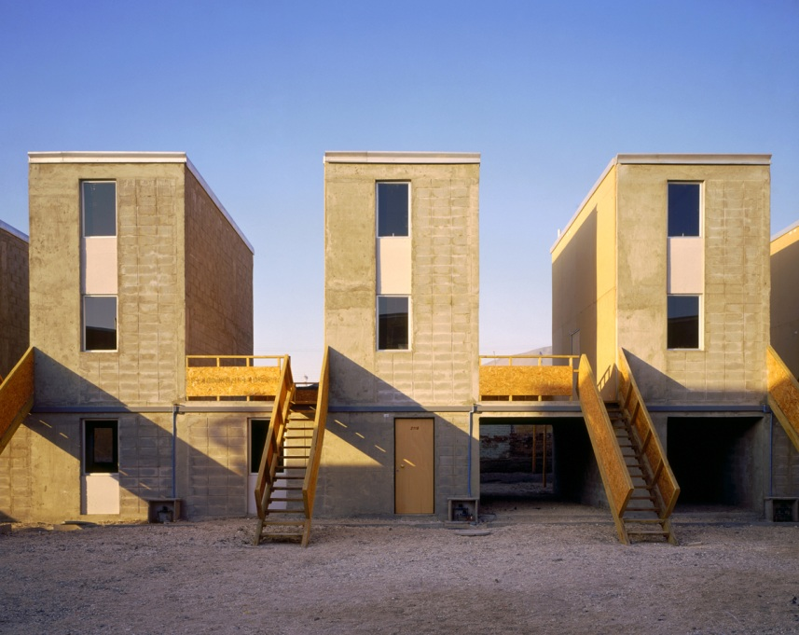
What is Housing Microfinance?
Loans used to help build incrementally - “Progressive build strategy”
Loans are often provided with:
Lending and Construction Assistance

Slide 6
Findings from Literature Review
Based on evidence on low income housing
from Latin America, Africa and South Asia

Slide 7
Demand for Housing Finance
The poor do possess land
Lack of documentation
But with limited legal title
Improvement in housing
Income levels
linked with increasing incomes
Build Assets
Housing as one of the most
valuable assets for the poor
Desire to improve
lifestyle
Desire to expand homes
Demand is evident

Slide 8
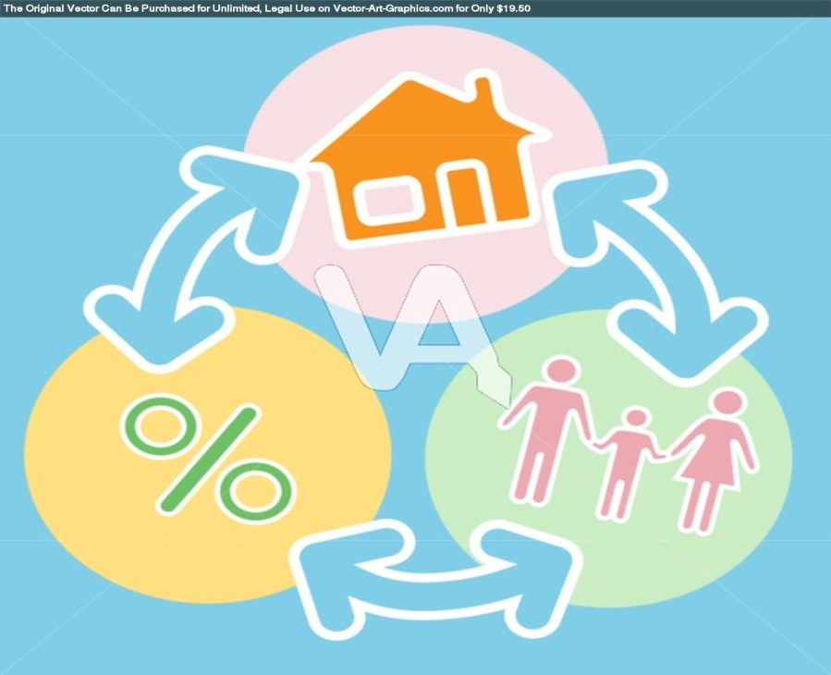
Supply of Housing Microfinance
Investors reluctance
Tenor
to provide funds for 10-30 years
Poor borrowers unable to
Repayments
sustain long period repayments
Lack of title documentation
Collateral
restricts borrowers access to mortgages

Slide 9
MFPs offer an alternative to these barriers through the provision of short term cash flow based credit
However Housing Microfinance continues to face barriers

Slide 10
Barriers to entry for MFPs
Assessing construction quality
Weak claim to land
Distortion of market by untargeted
subsidies
Commitment to social bottom line

Slide 11
What makes a viable HMF product?
Market Development & Regulation
Robust microfinance industry
Government commitment to social housing
Funding for microfinance portfolio
Strong regulation & monitoring
Before the take-off of a vibrant micro-housing or micro-mortgage market inputs are required

Slide 12
Product Features
Simplicity & Flexibility for individual borrowers
Long term loans & larger loan amounts
Alternative collateral requirements
Fixed installments
Optional funding for technical assistance
Cost-sharing of debt and equity
What makes a perfect product for the segment we cater to?

Slide 13
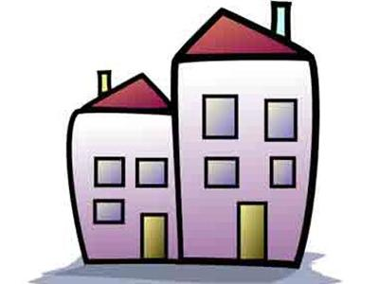
The situation in Pakistan

Slide 14
State of the Sector
Housing is a priority sector under
Medium Term Development Framework
GoP Recognition
Severe shortage of housing
8 million houses required
Shortage
No money for lending
a small portion of market demand met
Information asymmetry
Poor market infrastructure
cause investors to back off

Slide 15
Schemes for the poor
Income range – PKR 7,000 to PKR 15,000
Saiban Khuda Ki Basti
Karachi & Lahore,
Impacting 40,000 people
Orangi Pilot Program
Sindh,
Serving 2,500 people
Kashf Foundation & Tameer Bank
Nationwide
Provision of Housing Finance Loans
AJK, Goth Noor Muhammad, Sindh & Ehsanpur, Punjab
Post disaster reconstruction and Model Villages
PPAF
NRSP
Azad Jammu & Kashmir and Mianwali, Punjab
Provision of Post Disaster House Rebuilding Loans

Slide 16
Progressive HMF
The progressive housing microfinance model remains viable
Medium size loans
Tenors and repayments - cash flow
based
Coupled with Savings and Insurance
each loan would aim to add to existing
infrastructure

Slide 17
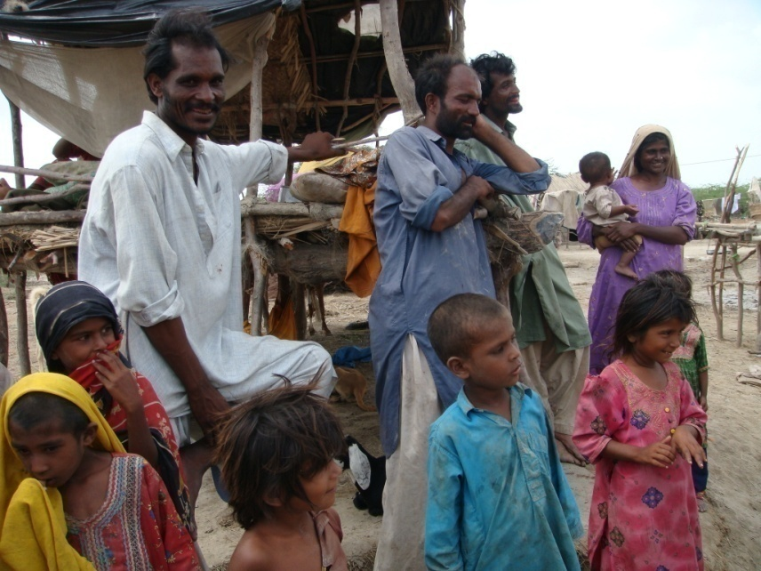
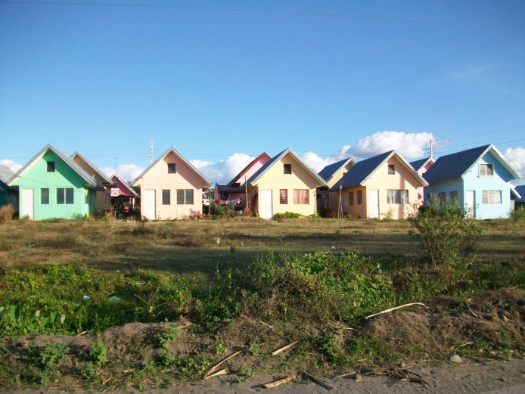
A model for micro-mortgages in peripheries
Equity from Government / donors
Income range
PKR 7,000 to PKR 15,000
Micro-mortgage
PKR 3,000-4,000/month
Equity contribution of client
Debt Burden - 20% - 40%
Housing Finance
Regulation
Technical Assistance

Slide 18
How can the equity contribution be made
The state may allot land
But with no resale rights
Or
Equity for joint ownership
As provider of
land
Equity convertible to debt after payment of initial micro-mortgage which may be used to purchase equity contribution by the client
Or
May be redeemed through sale with equitable distribution of profit based on ownership at the time of sale
Or
As Investor

Slide 19
Recommendations
Technical Assistance for MFPs
Technical Assistance for non-financial service providers
Regulation
Funding & Guarantees
Equity Partnership by Government and donors

Slide 20
Together we will transform microfinance in Pakistan
Restoring Hope
Securing the Future
Ending Poverty

