Slide 1
Accelerating Growth of Affordable Housing in Pakistan:
Harnessing Synergies between Governments, Developers and the Private Sector
ABAD/Jang-Group Conference on Affordable Housing
October, 2017
Zaigham M. Rizvi
Ex-Consultant World Bank
Low-Income Affordable Housing Programs and Policy Initiatives
Secretary General ASIA PACIFIC UNION FOR HOUSING FINANCE (APUHF)

Slide 2
Contents:
Housing Scenario and Challenges around the Globe and Asia-Pacific
Defining affordability for Low-Income Housing (LIH)
Stakeholders of Housing
Housing Challenges and Urban Planning
Self-Contained Communities for Housing
Electricity Poverty in Low-Income Housing
Challenges of Affordable Housing: Supply-Side
Challenges of Affordable Housing: Demand-Side
Low-Income Housing Issue and Answer: Case of Pakistan

Slide 3
World Population today is 7.12 billion, and by 2050 it will be 8.92 billion plus.
Almost half of the world lives on less than $ 2.50 a day, and four out of five under $ 10 a day
Worldwide, some 830 million people live in urban slums and by 2020, it is estimated that the world slum population will cross 1 billion.
Every second person (50%) on the globe lives in urban areas. This is expected to reach to 75% (which is 3 out of 4 persons) by 2050.
Slum dwellers grew from 777 million to 830 million during 2000-2010.
By 2030, around 40% of the world population, i.e., 3 billion plus, will require basic urban infrastructure and housing. (In 2014, China had 758 million urban dwellers, India 410 million, USA 263 million.)
World needs 4,000 houses an hour to keep up with the demand (UN-Habitat)
In view of this population and urbanization explosion:
The percentage of people without access to decent, stable housing is rising.
Adequate housing is vital to the health of the world’s economies, communities and populations.
If we are to succeed in the fight against poverty, we must support expansion of housing both as policy as well as practice.
Global Snapshot

Slide 4
Asian Snapshot
Asia-Pacific represents:
1/4th of the world’s population, and including China, nearly half of the world population resides in this region.
Nearly ½ of the world’s poor live here.
The region is faced with massive housing shortage. Nearly entire urban shortage is in low-income category
Awareness: Housing has become a popular political slogan.
“Housing for all”
“Slum Free Cities”
“Maang Raha hai har Insaan - Roti, Kapra, aur Makan” (Every human demands food, clothing and shelter), etc.
Delivery: In a few countries there is SOME, but in most other there is NONE
Each country in the region has its own geo-socio-economic parameters, while all face a common issue of “shelter less poor”.

Slide 5
Housing Challenge – in the Muslim World
IDB/IRTI* study suggests housing needs of the Muslim World are about 8.2 mn units, nearly all in the Low-Income Segment. The estimate needs further analysis.
The breakdown is as follows:
MENA 3.2 mn;
Asia 2.7 mn; and
Africa/others 2.3 mn.
Shortage: Egypt 1.5 mn, Iraq 1.0 mn, Morocco 0.6 mn, Saudi Arabia 0.4 mn
Significant oversupply in upscale or luxury housing only, while low income segments/ communities remain neglected
Rapid urbanization is a major issue for low income housing
Need for new housing for 8 mn plus due to population growth is based on 5-5.5/HH and population growth rate of 2.8%
Urbanization and population growth further increases the annual housing needs in major metropolitans
On the other side, supply is 30-40% of new demand, all for high income segment.
*Islamic Development Bank/Islamic Research and Training Institute Report on Housing-2012

Slide 6
* IRTI-IDB Occasional paper, 2012. OIC and IDB membership is the same. **www.IslamicPopulation.Com
Housing is a ‘Numbers’ game –
Muslim World is no exception!
IDB member Countries need around 8.2 mn new housing units/year. To meet this yearly demand they will need US$ 15.5 Bn/year of investment in housing sector.*
The yearly requirement of housing in Muslim World is growing at 2.83% p.a.
Sharia-Compliant Housing Finance in Muslin Countries is around 20% only.
Muslim Population Share: Africa-53.0 %, Asia-32. 2%, Europe-7.6 %, N. America-1.8 %**
Urban population of IDB member countries is growing at 2.8%/year (Worldwide growth 0.5%).
The total urban population of IDB Member Countries was 731 Mn in 2010, representing nearly half of total population of IDB member countries
MD to GDP Ratio is highest in Malaysia (32%), and lowest in Pakistan and Egypt (below 1%).
Institutionalized housing finance is at infancy stage in most of these countries

Slide 7
Market Segmentation for Affordability:
Market Housing:
Represents High and Middle Income Market Segments
Market Segment is addressed by the market forces on its own without any need for state-intervention or support
Supply is there to meet the demand
Social Housing:
Represents lower-middle and low-income market
Social segment needs state-intervention/support to facilitate affordable housing supply and an enabling environment –LIH Segment
Bottom of the Pyramid: The candidates for housing microfinance, needing delivery through direct/indirect state subsidies. This is the Economically Weaker Segment (EWS)

Slide 8
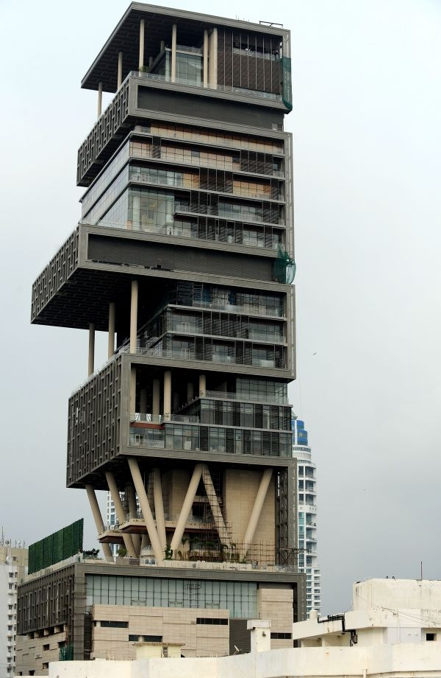
Affordability Defined….haves
ANTILIA: Mukesh Ambani House Mumbai One Billion Dollar, 27 Story, 400,000 Area, 600 Staff to maintain
Mr. Ambani does not live in it
Affordability is not what you have

Slide 9
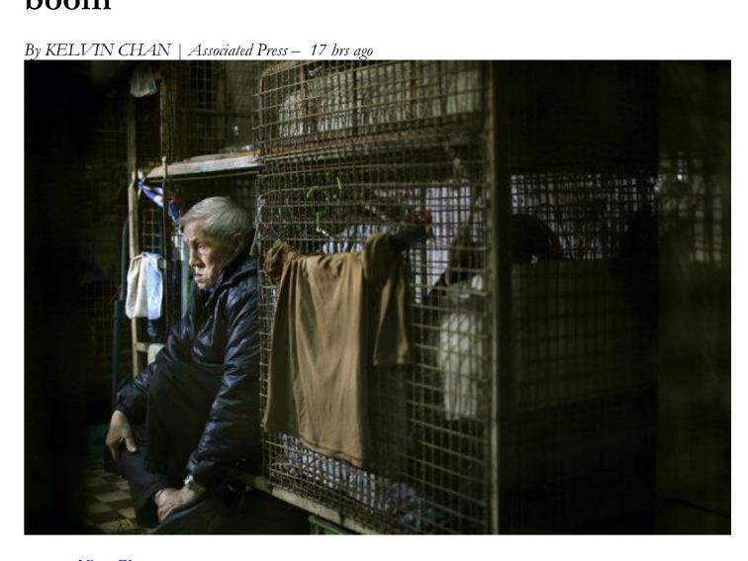
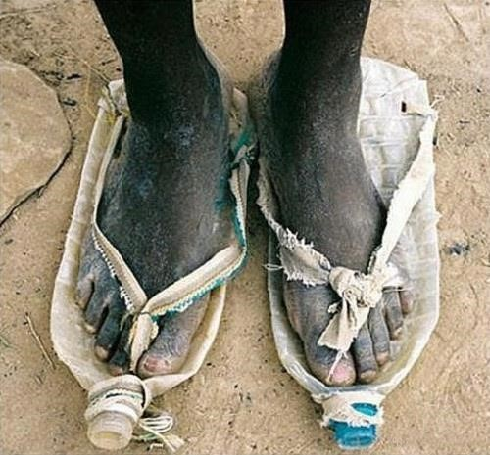
Affordability Defined….have-nots
Cage Housing in Hong Kong
Shoes made of used Mineral Water Bottles
Affordability is what you essentially need and would like to have
Therefore poor are obliged to find their own ways in housing ….they develop slums

Slide 10
Stakeholders of Housing
Government at federal and provincial levels (Govt.): Facilitator and Enabler Role.
Urban Planners (UP): Integrator of Housing with Urban Planning.
Fiscal Authorities (FAs): Providers of Fiscal incentives to LIH Developers and Material Suppliers.
Regulatory Agencies like central bank, building control authorities etc. (RAs): Makers and implementers of codes for FAs, Building etc.
Academia (Acad): People involved in research and development on Urban Planning, Housing and Construction Materials.
Developers (Dev): People doing development of large scale LIH, Construction Technologies, work under PPP Models
Construction Materials Industry (CMIs): Provider of standardized CMIs and manufacturing scale production.
Housing Finance Companies and Commercial Banks HFCs/CBs): Providers of Diversified Housing Products, Expansion of outreach
Land Agencies/Land Banks (Land): Arranger and manager of Raw Lands and Serviced Lands, enhancing supply of lands under PPP modes.

Slide 11
Innovative approaches in urban planning to address the issues of rapid urbanization, housing backlog and cost/income affordability.
Regulations on densification: Inner city expanding in circles around circles resulting in further densification. Issues of rezoning, development of “Serviced Land” etc.
Alternative options to act against slums prevalence, expansion, and inefficient use of land.
Resettlement and Rehabilitation Projects
Plan and develop new neighborhood/satellite towns equipped with physical, social infrastructure, and transport etc.
Platform for on-going coordination and wisdom sharing between Urban Planners, Housing Ministry, Developers, Academia and Research Centers etc.
Business model of Public-Private Partnership for viable, self-sustainable plans and projects
Housing Challenge and Urban Planning

Slide 12
Self-sustained Communities for Housing
Social Infrastructure: Health, Education, Community participation
Physical Infrastructure:
Internal: Roads, Electricity, Sewerage, Water, Playground
External: Roads, Communication, Transport
Economic Infrastructure: Commercial opportunities within the community
Location: Maximum one hour commuting time to job
Energy efficiency: Houses maximizing use of Wind and Solar
If Off-Grid, then communities be equipped with alternate energy sources
Affordable housing should be more than just a roof over someone’s head — it should create solutions to provide residents with decent housing, and strengthen communities.

Slide 13
Energy ( Electricity) Poverty around Globe and in Asia
Nearly 1.3 billion people worldwide live without any access to electricity (being Off-Grid).
Asia has the largest off-grid population in the world, where nearly 800 million live in near darkness.
India alone has 400 million off-grid, which is 35% of their population.
Pakistan’s 60 million, that is 30% of the population, is off-grid.
Kerosene lamps, used as a source of lighting, are potential threat of fire and cause of environmental pollution in small rooms, which are mostly without ventilation.
In India alone expenditure on kerosene lamps is estimated to be $ 2.2 billion/year.
In Bangladesh 17 million out of total 29 million households are off-grid.
In Indonesia 20 million households out of total 57 million are off-grid.
Extending grid-electricity to these household is a remote possibility in the near future due to economic constraints and under-electrified grids.
Alternate and renewable energy resources, mainly solar energy, is the doable and affordable option
Source: FC on Lighting Global and Lighting Asia

Slide 14
ISSUE: Supply of Serviced land at affordable price: Availability of well-connected affordable land remains a main concern in major metropolitan cities of Asia. Affordable land is often not well connected to transportation and other public services.
ANSWER: External Infrastructure support, in terms of physical and social infrastructure, should be a part of affordable supply of serviced land by the state. (Stakeholders: Govt.., UP, and Land)
ISSUE: Rising Construction Costs: According to developers across cities in India, their construction cost has increased by 15-20% on yearly basis. LIH is a ‘low-margin’ business, making it less attractive, more so in case of delays.
ANSWER: Fiscal support in terms of waiver of Sales Tax, Import duties, and other levies.
(Stakeholders: FAs, CMIs. Dev)
ISSUE: Lengthy and Complex Approval Process: This impacts construction timelines, project IRR and pricing. The approval fees/costs further adds to the unit price.
ANSWER: Simplified approval procedures, on-line status, monitoring, waiver or discount of approval fees etc. (Stakeholders: Govt.. , RAs)
Challenges of Affordable Low Income Housing (LIH): Supply Side

Slide 15
Challenges of Affordable LIH: Supply Side- Cont’d
ISSUE: Developer /Construction finance from financial institutions and capital markets is not easily accessible, due to absence of Developer Finance Regulations in most of the countries. Developers fund the projects through short term in-house funding or through customer finance.
ANSWER: The Central Banks and Securities Commission to play a proactive role in facilitating market based supply of Long Term Funding for the developers.
(Stakeholders: RAs, HFIs)
ISSUE: Absence or insufficient Fiscal Support for LIH projects.
ANSWER: Business Models of indirect Cross-Subsidies and direct Smart Subsidies to LIH/EWS projects will provide fiscal incentives to developers.
(Stakeholders: FAs, Govt.., Dev)
ISSUE: Absence of or insufficient Regulatory Support to LIH/BoP Segments.
ANSWER: Regulatory incentives in terms of FARs, and wherever permissible, relaxation in Building Codes etc. without compromising on strength. (Stakeholders: RAs)

Slide 16
Challenges of Affordable LIH: Supply Side- Cont’d
External Infrastructure: Government needs to ensure that Raw Land for LIH Projects is supported by way of external infrastructure in terms of roads, transport, communication, as well as provision of health and education.
From Raw Land to Serviced Land. (Stakeholders: UP, Municipalities)
Transport: At the initial stage of LIH Project, public transport be provided.
(Stakeholders: Municipalities)
Non-availability of Low-Cost Construction Technologies. The Developers need to be facilitated and supported to import and indigenize Low-Cost Construction Technologies for manufacturing large scale production. (Stakeholders: Dev, Academia)
Lack of Low-Cost Construction Materials (CMIs): The Govt.. needs to promote local development of low-cost construction materials, and regulate standardization of CMIs for use in LIH projects.
(Stakeholders: CMIs, Dev, Academia)
Manufacturing Scale Production: The development projects and the developers are of small size, thus denying the benefits of economies of scales, and use of proven low-cost construction technologies. (Stakeholders: Dev, Academia)

Slide 17
Challenges of Affordable LIH: Demand Side
Mismatch of Monthly Mortgage vs Income Affordability. At lower income levels, propensity to save is low and fragile (Stakeholders: HFIs)
Income assessment issues, informal income, issue of family vs. individual income etc. Income sustainability for long term remains an issue while longer tenors are needed to make mortgages affordable. (Stakeholders: HFIs, RAa)
Poor prefer FRMs, the Lenders prefer ARMs (Stakeholders: HFIs)
Long term liquidity/Funding challenges (Stakeholders: RAs, Long Tern Liquidity Institutions).
Issues of title verification, lien registration costs/fees, lengthy and complex foreclosure process. (Stakeholders: Land, Govt.., Municipalities)
Cost efficient loan delivery and servicing. (Stakeholders: HFIs)
Awareness on mortgage programs and fiscal/regulatory provisions. (Stakeholders: RAs, HFIs)

Slide 18
Challenges of Affordable LIH: Demand Side- Cont’d
Specialized HFCs are needed to finance Low-Income Segment. (Stakeholders: RAs, HFIs)
Commercial banks (CBs) prefer middle and high-income market, low-income housing finance by CBs be placed under priority lending regulations. (Stakeholders: RAs, HFIs)
Housing Microfinance Institutions for BoP/EWSs. (Stakeholders: RAs)
Ensure outreach and financial inclusion to low-income segments, through innovative channels like physical branches, virtual branches, service agents, service on wheels etc. (Stakeholders: RAs, HFIs)
Customers’ lack of awareness on affordability, payment terms, registration & clearance of titles, and available fiscal/regulatory support. (Stakeholders: RAs, HFIs)
Delay in home delivery leads to simultaneous payment of rent and EMI. (Stakeholders: Dev, HFIs)
Provide interest rate subsidy to low-income customers (Stakeholders: Govt., RAs)
Waive or subsidize levies like VAT, stamp duty and registration fees for low-income customers (Stakeholders: FAs, Govt.., HFIs)

Slide 19
HDFC-India: a model housing finance institution on global scene
Housing Development Finance Corporation Ltd (HDFC) of India was incorporated in 1977 as a specialized housing finance intuition (SHFI) in the private sector.
Over the years it has grown into a financial conglomerate, having established eight subsidiaries of its own, which include a HDFC Commercial bank, Life and General Insurance, Asset Management, Property Valuation, Venture Capital, Financial Services and an institution to serve low-Income housing segment (GRUH Finance).
HDFC’s outstanding Gross Loan Portfolio stands at US$ 43.8 billion as of March 2016.
Over the years it has served 5.4 million customers (March 2016),
HDFC is surving1,000 plus clients /day and its yearly average loaning is IRs 200-250 billion. (Pakistan total PRs $ 0.7 billion, and HBFC at $ 0.15 billion)
India has 65+ SHFIs, and its overall outstanding mortgage debt is IRs 8 trillion
HDFC PAT CAGR is 18%; including subsidiary profits, 23%.
Cost to Income Ratio at HDFC is only 7.6%.
Total loans written off since inception are only 4 basis points of cumulative disbursements.
HDFC has a wide distribution network, based on physical and virtual offices. HDFC had 401 offices in 173 cities. In addition, it has 103 outlets of HDFC’s wholly owned Distribution Company.

Slide 20
Low-Income Housing Challenge
Case of Pakistan
For a population of 190 million, household size of 6.6 and population growth rate of 2.5%, the incremental demand for housing for new household is 0.7 million units per year.
Urban population is nearly one-third of the total population.
With changing socio-economic norms, household size will shrink from 6.6 to lower levels, leading to more demand for housing units for the same population. (India 5.6)
Overall housing backlog is 8-9 million
The urban housing shortage is around 3.0-3.5 million, nearly all of which is in the economically weaker section (EWS) of the population.
The yearly housing supply is around 0.25-0.30 million, therefore, short supply is adding another 0.3-0.4 million every year to the existing backlog.
Depletion of old housing stock will further widen the shortage.
The rural housing shortage is 5 million units, being neglected so far.
Rural housing calls for a different approach to address the issue of housing supply and housing finance.
Notes:
20

Slide 21
The Housing Program addresses the low-income housing shortage from three different aspects:
Demand Side (Shelterless Poor Housing Finance),
Supply Side (RE Developer Industry) and
Regulatory aspects (SBP, SECP, Building Codes Regulations, Fiscal/Tax Regulations of FBR).
Housing has three market segments:
Market Housing: The needs of those who can afford are being met by the market already. They are not the target of the Program
Squatter Settlements – Rehabilitation/Resettlement of squatters and discouragement of further squatter settlements.
Under the new Housing Policy being proposed, the Govt.. will launch programs to address this segment as well.
Social Housing: Low-Income Pro-Poor Affordable Housing, needing Government support.
THIS IS TARGET MARKET of PM Low Income Housing Program
Prime Minister’s Low Income Housing Program:
1,000 satellites having 500 units each

Slide 22
Actions taken so far:
Steering Committee and its 5 Working Groups had worked out set of recommendations, policy and business plan in Oct 2013.
Apna Ghar Co. Ltd, as a vehicle to deliver on the program has been registered and its Board of Directors is now functional.
The Board of Directors of Apna Ghar Ltd, in its second meeting, has adopted the set of recommendations of the Steering Committee and 5 Working Groups for onward implementation and moving forward.
What needs to be done:
Since land is a provincial subject, housing became a provincial subject.
Procurement and preparation of Land for development of housing under different modes including PPP .
Execution of Low-Income Housing Program (LIH Program) would involve different stakeholders, both at the Federal and Provincial level
Regulatory Agencies like FBR (for Fiscal), SBP (for Finance), and Building Control Authorities need to be taken on board.
A need to set up a strong authority at Prime Minister’s secretariat to execute, monitor and facilitate
Apna Ghar Ltd
Apna Ghar (My House) Program, a commendable Initiative that needs strong and fast track implementation

Slide 23
No of Housing Units
 | Year-1 | Year-2 | Year-3 | Year-4 | Year-5 | Total
Public-Public | 10,000 | 20,000 | 30,000 | 40,000 | 50,000 | 150,000
Public-Private PM LIH Apna Ghar Program | 75,000 | 100,000 | 100,000 | 100,000 | 125,000 | 500,000
Sub total (Govt.) | 85,000 | 120,000 | 130,000 | 140,000 | 175,000 | 650,000
Private-Private* | 315,000 | 380,000 | 470,000 | 660,000 | 825,000 | 2,650,000
Grand total | 400,000 | 500,000 | 600,000 | 800,000 | 1,000,000 | 3,300,000
* The Private Sector is currently supplying housing units at 300,000 per year and it needs to be facilitated/enabled to enhance its production over the years, totally on market basis.
APNA Ghar Housing Supply Targets
23

Slide 24
Steering Committee for PM LIH Program
For this purpose the Govt.. has set up a high level Steering Committee, headed by the Finance Minister.
The Steering Committee had set up five Working Groups to address issues and answers in the related areas, which are:
Working Group on Policy, Planning and Building Codes
Working Group on Housing Finance & Fiscal Incentive
Working Group on Private Sector Participation and Innovative Models
Working Group on Legal Reforms Governing Housing Sector
Working Group on and Identification, Allocation and Notification

Slide 25
SBP to be directed to play a pro-active and effective role in promotion of housing and housing finance, with a target to improve MD:GDP Ratio from 0.5% to 5% within 5 years.
SBP to complete various regulatory initiatives in hand which are essentially needed for successful implementation of housing mission of the Government.
SBP and MoF to ensure that HBFC and Commercial Banks are fully geared to play their due role in providing housing finance to the beneficiaries/clients under APNA Ghar Program Housing specific Prudential Regulations
SBP to ensure fast-track launch of Mortgage Finance Guidelines, Housing Microfinance Regulations and Guidelines, Pakistan Mortgage Refinance Co., Long Term Liquidity Instruments like REITS, Mortgage Backed Securities and Developer Finance Regulations
Regulatory Role of SBP - the Finance-Side Regular

Slide 26
The SECP, as a regulator of the corporate sector, is to play a proactive role in promotion and regulation of housing supply agents like Developer Industry, Construction Materials Industry etc.
SECP to launch Real Estate regulatory initiatives under process like Real-Estate Regulatory Regime, Guidelines on Private-Public Partnership, Guidelines on Property Valuation etc.
Real Estate Regulatory Act (RERA): SECP to announce RERA to ensure discipline, confidence, and enforcement of rules, regulations and policies
Guidelines on Private-Public Partnership, Property Valuation
Role of Building Control Authorities: Relaxed regulations like FARs for Low-Income Housing, Fees etc.
Role of Architects and Civil Engineering Designers
Role of Urban Planners in Housing: Urban planning to cover development of new habitat, social and physical infrastructure etc.
Regulatory Role of SECP and other Stakeholders:
26

Slide 27
Developer Industry to play a key role in production of Low-Income Housing on manufacturing scale production to provide economies of scale.
Developers to maximizing use of role of construction technology and innovation and standardization of construction materials.
The Developer Industry may need to have technology transfer under joint ventures with large scale developers in the region
Developers may also develop and promote low-income housing schemes outside PM’s LIH Program
Academia: To enhance role of universities and academia in finding economical solutions for Low-Cost Housing, the Govt.. to set up Housing and Urban Development Departments of Universities.
The Govt.. to set up Housing Information System (Housing Observatory)
The National Policy on Slums to cover policies and programs on slums rehabilitation and resettlements.
Role of ABAD and Academia

Slide 28
Different stakeholders were under different administrative regimes.
An apex body was not in place to bring them on the table to collectively serve the mission.
In Pakistan, while land and housing is a provincial subject, the Federal Govt. attempted to be the champion of delivery.
Provinces would have accepted Federal Role as enabler and facilitator, but not as deliverer.
One key recommendation of steering committee was to “Set up a lean but strong function at Prime Minister’s Secretariat to execute, monitor and facilitate Apna Ghar Ltd”.
In view of the above factors, the Low-Income Housing Program could not effectively move beyond drawing table.
Defining role of Housing Stakeholders is one thing but getting them in unison on the table is critical for delivery.
Why LIH Program in Pakistan could not deliver its target

Slide 29
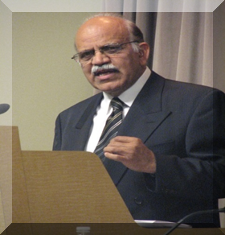
The information has been compiled by Mr. Rizvi from self study and from different sources. He is grateful to all those serving this noble cause in some form or the other.
Zaigham M. Rizvi
zaigham2r@yahoo.com
Secretary General: Asia-Pacific Union for Housing Finance-APUHF (www.apuhf.info)
Served/Serves as Housing Adviser/Consultant to:
World Bank/IFC, UNHABITAT, CMHC-Canada
Affordable Housing Institute-USA (AHI)
Includes-USA (ShoreBank Int’l )
State Bank of Pakistan (The central bank)

